Slide 1
Grade 9
Notes:
The lesson plans use the terms ‘male’ and ‘female’ when referring to biological sex (sex assigned at birth), such as when discussing reproductive anatomy.
People are assigned a sex at birth based on their reproductive anatomy. Sex assigned at birth is independent of gender identity. Gender identity is a person’s internal sense of identity as female, male, both or neither, regardless of their biological sex assigned at birth.

Slide 2
Types of Communication
Assertive
stand up for their rights without denying other people theirs
respect themselves as well as others
ask for what they want in a straightforward manner
express their emotions (both positive and negative) in a healthy manner

Slide 3
Types of Communication
Passive
give in and say yes even when they don’t want to
put the feelings and concerns of others before their own
keep their concerns to themselves

Slide 4
Types of Communication
Aggressive
think of themselves first, at the expense of others
dominate others
use threats or force

Slide 5
Types of Communication
Passive-Aggressive
may seem to agree to avoid confrontation (passive) but will manipulate others to say things for them, or say things behind someone’s back (aggressive)

Slide 6
Communication Styles
Other’s wants
Your wants
Passive
Aggressive
Assertive

Slide 7
Alcohol

Slide 8
Amounts of Alcohol

Slide 9
Video Demonstration Links
Condom
Vaginal Condom
Dental Dam

Slide 10
Effectiveness
Method | STI Protection | Pregnancy Prevention (Typical use) *
Abstinence |  | 
Injection |  | 
Pill/ Patch/ Ring |  | 
Implant |  | 
Condom |  | 
Emergency Contraception |  | **
IUD |  | 
Vaginal Condom |  | 
Withdrawal |  | 
No Method |  | 
= None = Fair = Good   = Excellent
Notes:
*Some birth control methods have much higher effectiveness ratings in ‘perfect use’ conditions. For a comparison of the difference between perfect and typical use, see the Birth Control Effectiveness Graph.
** The contraceptive effectiveness rate for emergency contraception depends on what kind is used, and how soon after unprotected sex it is used. See the Health Information Sheet on emergency contraception for more information.

Slide 11
Birth Control Effectiveness
Notes:
Effectiveness rate for typical use refers to how effective each method is at preventing pregnancy during actual use including incorrect or inconsistent use.

Slide 12
Birth Control Effectiveness
Notes:
Effectiveness rate for typical use refers to how effective each method is at preventing pregnancy during actual use including incorrect or inconsistent use.
Effectiveness rate for perfect use refers to how effective each method can be at preventing pregnancy when the user follows the exact directions all the time.
Fertility Awareness Based Methods (FABs) help people understand how to prevent a pregnancy by not having sex during the fertile time. There are many different methods, including the calendar rhythm method, basal body temperature, cervical mucous and symptothermal method. These methods include some form of tracking menstrual cycles, charting body temperature or observing changes in cervical mucous to help a person determine days they are less likely to get pregnant. FABs require a lot of practice to learn how to use consistently and can be difficult because not all menstrual cycle are regular.
Spermicides includes vaginal contraceptive film, foams, gels, creams, and vaginal suppositories.

Slide 13
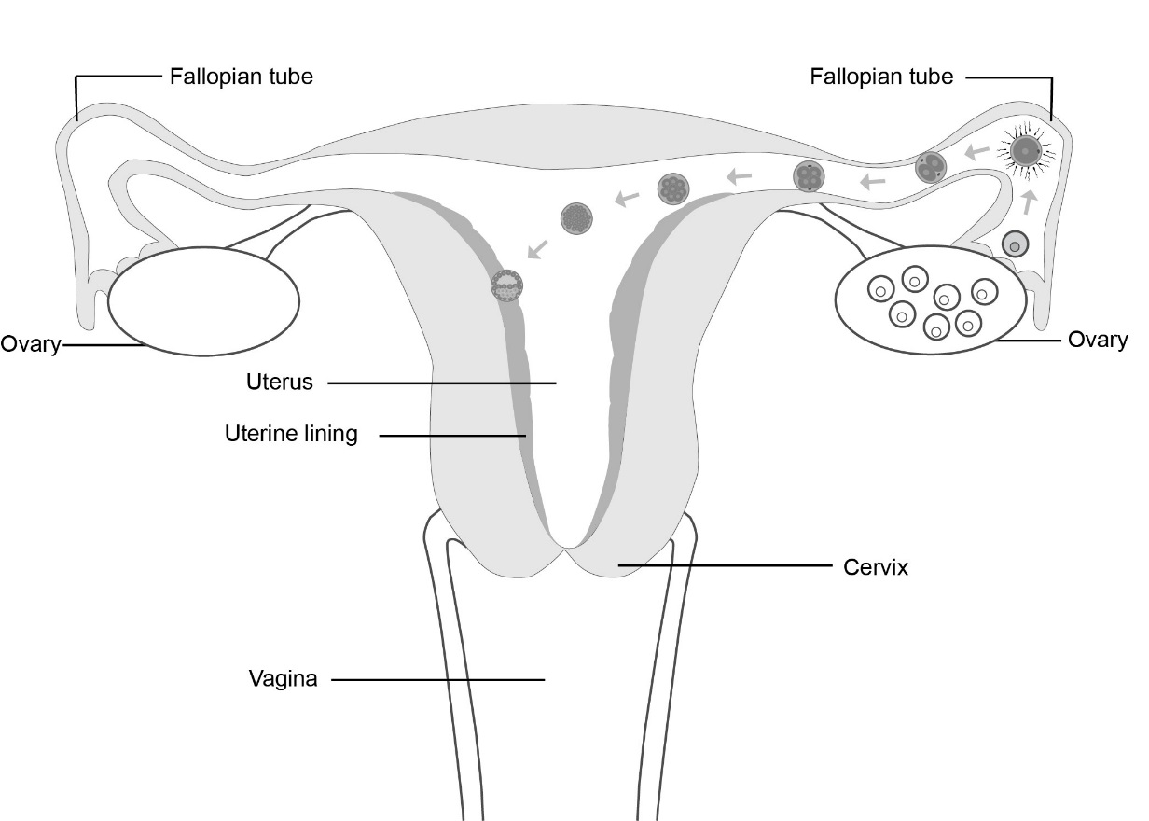
Implantation

Slide 14
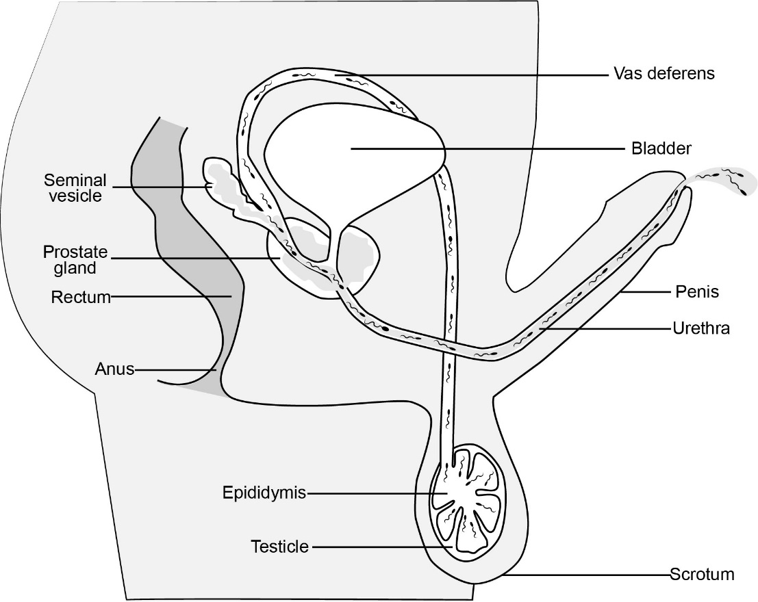
Sperm Production

Slide 15
Looking for a motivated individual to bring a baby into this world. The candidate will raise the child and continue to put the child’s needs and requests before their own for at least 18 years.
Start date: 9 months from now
Salary: none
Vacation: none
Working hours: 24/7/365
Please do not apply if you cannot work overtime or want a life of your own.

Slide 16
Additional Resources
Additional anatomy diagrams are available on the Grade 7 page.

