Slide 1
CONSENT
Which Path Would YOU Take?
©2020

Slide 2
This is Alex and Riley. They are in grade nine and have been dating for almost 6 weeks.

Slide 3
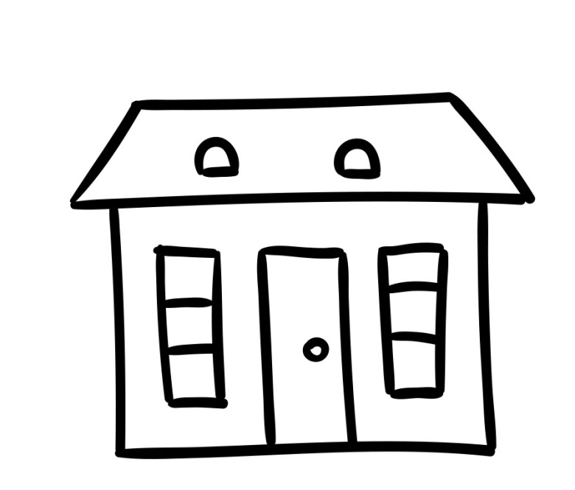
They met at _________
a friend’s house | b) a soccer game | c) school

Slide 4
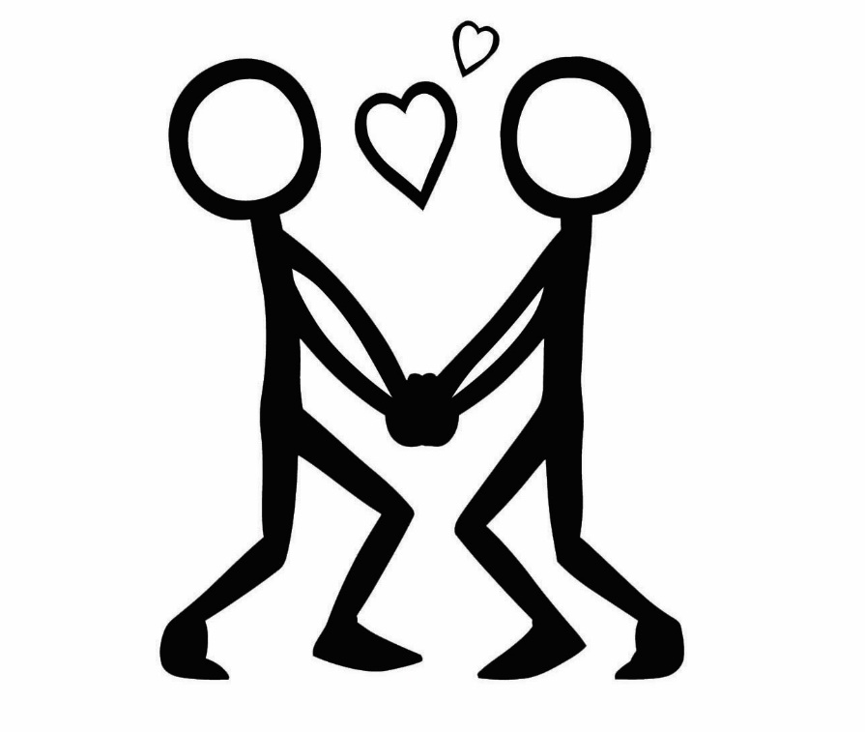
Alex and Riley spend a lot of time together. They like to hold hands and hug. But Alex really wants to make out with Riley. So Alex…
goes for it and kisses Riley.
asks Riley, “Can I kiss you?”
says, “I would really like to kiss you.”

Slide 5
Riley responds…
by kissing Alex.
“I would like to kiss you too!” So they kiss.
“No, I’m not ready to kiss you.”

Slide 6
Because Riley agrees to kissing, Alex thinks it’s the green light to touch Riley’s butt. Riley responds by…
saying, “That feels nice” and also touches Alex’s butt.
pushing Alex’s hand away.
freezing, not knowing what to do or say.

Slide 7
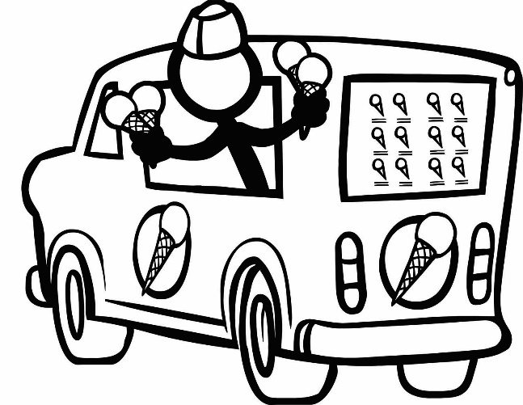
Alex realizes that consent was not received to touch Riley’s butt and knows it’s time to stop making out. Alex asks Riley, “So what do you want to do now?” Riley says…
Go for an ice cream | b) Go to a movie | c) Finish homework

Slide 8
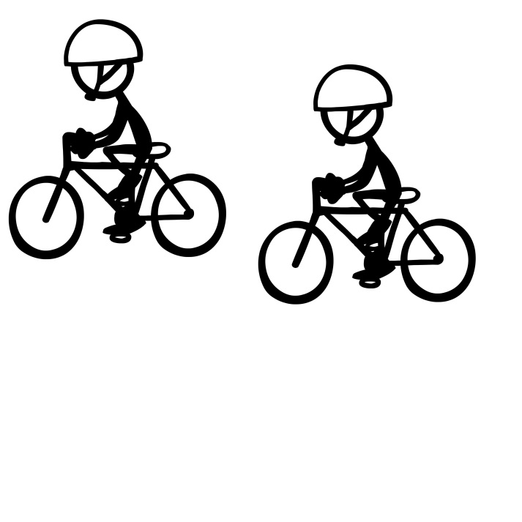
Alex senses that something is off and says “You don’t seem into this, so should we stop?” Riley says “I’m not ready to take this further.” Alex replies, “Ok, so what do you want to do now?”
Go eat pizza? | b) Go for a bike ride? | c) Go watch a movie?

Slide 9
After a while of making out, Alex and Riley decide to stop. It’s time to do something different so they…
eat pizza | b) go to a movie | c) go for a bike ride

Slide 10
Riley…
is thrilled and wants to kiss Alex back. But first Riley says “Hey, you should ask first before you kiss someone. I want to kiss you, okay?” Riley nods and then Alex and Riley kiss.
b) says “Please stop I’m not ready for this.”
c) freezes, not knowing what to do or say.

Slide 11
Because Riley is fine with kissing, Alex thinks it’s the green light to touch Riley’s butt. Riley responds by…
saying, “That feels nice” and also touches Alex’s butt.
b) pushing Alex’s hand away.
c) freezing, not knowing what to do or say.

Slide 12
Alex realizes that they did not get consent to touch Riley’s butt and knows it’s time to stop making out. Alex asks Riley, “So what do you want to do now?” Riley responds…
Eat pizza | b) Go to a movie | c) Go for a bike ride

Slide 13
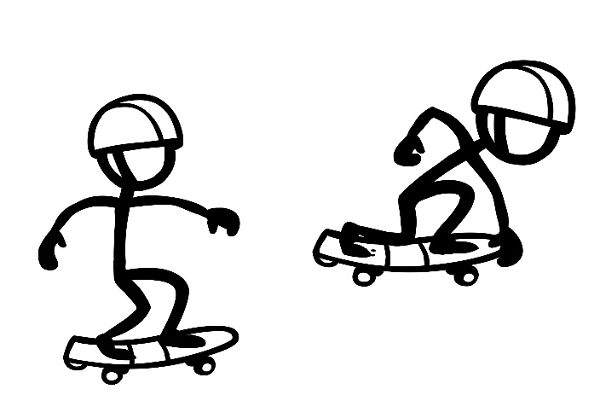
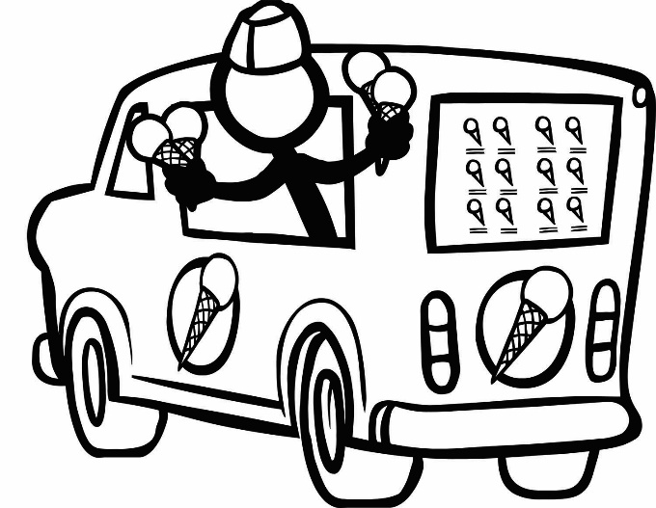
Alex senses that something is off and says “You don’t seem into this, so should we stop?” Riley says “I’m not ready to take this further.” Alex replies, “Ok, so what do you want to do now?”
Go skateboarding? | b) Go watch a movie? | c) Go eat ice cream?

Slide 14
Alex says…
“Please can we kiss? Come on… I really want to take this to the next level.”
“Ok, I understand but can we talk about this again sometime?”

Slide 15
Once again, Riley says “no.” Alex replies…
“Come on! We’ve been dating forever. Besides, you’re such a tease. You hug me all the time so that means we should make out.”
“Ok, I’m sorry if I was pressuring you. I just really like you a lot. Can we talk about this again when you’re ready?”

Slide 16
Riley says, “No, I’m not ready.” Alex replies, “You clearly don’t like me as much as I like you. Maybe we should break up.” Riley answers, “Fine, we are broken up. I’m going to ________ with my friends now. Bye!”
eat pizza | b) go to a movie | c) go for a bike ride

Slide 17
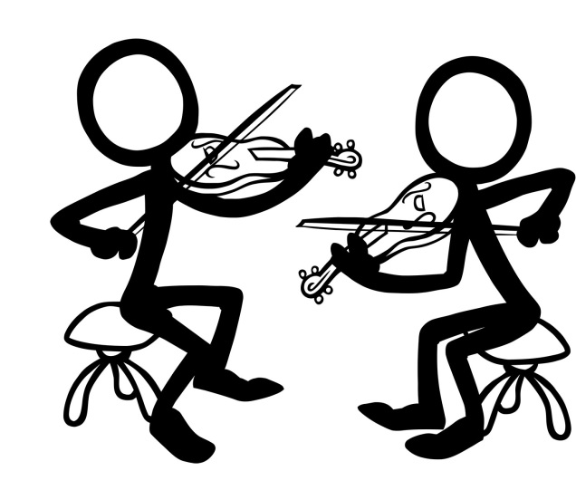
Riley says, “Thanks for being cool about it. Let’s talk about this again sometime.” What do you want to do now?
Go to band practice | b) Shoot hoops | c) Listen to music

Slide 18
Alex…
senses that something is off and says “you really don’t seem into this.”
keeps kissing Riley who must be ok with this since Riley did not say “stop” or push Alex away.

Slide 19
Riley says “I’m not ready for this.” Alex replies…
“Come on! We’ve been dating forever. Besides, you’re such a tease. You hug me all the time so that means you should kiss me. If you don’t kiss me, I’ll break up with you.”
“I’m sorry, I should have asked you before I tried to kiss you.”

Slide 20
Riley becomes even more distant and is not responding. Alex says…
“Why aren’t you kissing me back? You don’t seem to like me as much as I like you. Maybe we should break up.”
“Are you ok with making out?”

Slide 21
Reilly says, “I’m just not ready for this. I hope you understand.” Alex replies, “Of course I understand. But can we talk about this when you’re ready?” Riley says, “Absolutely. What do you want to do now?”
Eat pizza? | b) Go to a movie? | c) Go skateboarding?

Slide 22
Riley says, “That’s ok we’re cool. Yes we should talk before we take things further. What do you want to do now?”
Eat pizza? | b) Go to a movie? | c) Go skateboarding?

Slide 23
Riley says, “Fine, then let’s break up. I’m going to ________ with my friends now.”
go for a walk | b) shoot hoops | c) listen to music

Slide 24
The End
Back to the beginning

