Slide 1
Grade 8
Notes:
The lesson plans use the terms ‘male’ and ‘female’ when referring to biological sex (sex assigned at birth), such as when discussing reproductive anatomy.
People are assigned a sex at birth based on their reproductive anatomy. Sex assigned at birth is independent of gender identity. Gender identity is a person’s internal sense of identity as female, male, both or neither, regardless of their biological sex assigned at birth.

Slide 2
Effectiveness
Method | STI Protection | Pregnancy Prevention (Typical use) *
Abstinence |  | 
Injection |  | 
Pill/ Patch/ Ring |  | 
Implant |  | 
Condom |  | 
Emergency Contraception |  | **
IUD |  | 
Vaginal Condom |  | 
Withdrawal |  | 
No Method |  | 
= None = Fair = Good   = Excellent
Notes:
*Some birth control methods have much higher effectiveness ratings in ‘perfect use’ conditions. For a comparison of the difference between perfect and typical use, see the Birth Control Effectiveness Graph.
** The contraceptive effectiveness rate for emergency contraception depends on what kind is used, and how soon after unprotected sex it is used. See the Health Information Sheet on emergency contraception for more information.

Slide 3
Birth Control Effectiveness
Notes:
Effectiveness rate for typical use refers to how effective each method is at preventing pregnancy during actual use including incorrect or inconsistent use.

Slide 4
Birth Control Effectiveness
Notes:
Effectiveness rate for typical use refers to how effective each method is at preventing pregnancy during actual use including incorrect or inconsistent use.
Effectiveness rate for perfect use refers to how effective each method can be at preventing pregnancy when the user follows the exact directions all the time.
Fertility Awareness Based Methods (FABs) help people understand how to prevent a pregnancy by not having sex during the fertile time. There are many different methods, including the calendar rhythm method, basal body temperature, cervical mucous and symptothermal method. These methods include some form of tracking menstrual cycles, charting body temperature or observing changes in cervical mucous to help a person determine days they are less likely to get pregnant. FABs require a lot of practice to learn how to use consistently and can be difficult because not all menstrual cycle are regular.
Spermicides includes vaginal contraceptive film, foams, gels, creams, and vaginal suppositories.

Slide 5
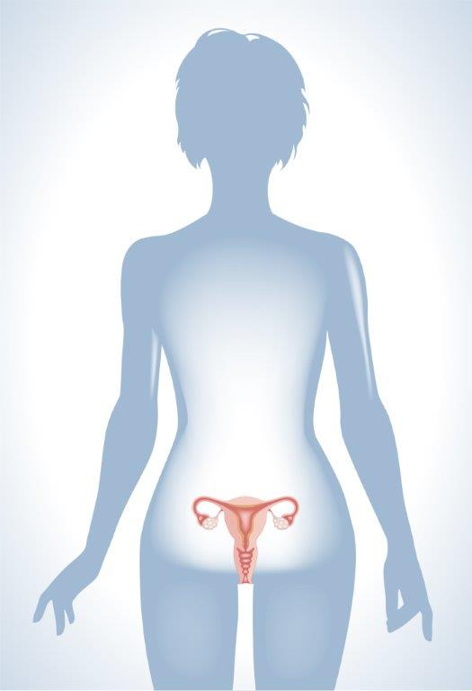
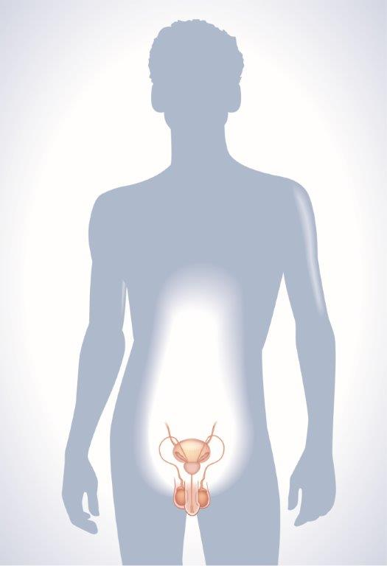
Reproductive Systems
Notes:
This is a good introductory slide so that students can understand the relationship of the reproductive organs to the rest of the body. Show this slide and discuss the difference between internal and external. Then introduce the difference between frontal views and side views of the body. The female reproductive organs are shown primarily using the frontal view, while the male reproductive organs are shown primarily using the side view.
The lesson plans use the terms ‘male’ and ‘female’ when referring to biological sex (sex assigned at birth), such as when discussing reproductive anatomy
People are assigned a sex at birth based on their reproductive anatomy. Sex assigned at birth is independent of gender identity. Gender identity is a person’s internal sense of identity as female, male, both or neither, regardless of their biological sex assigned at birth.

Slide 6
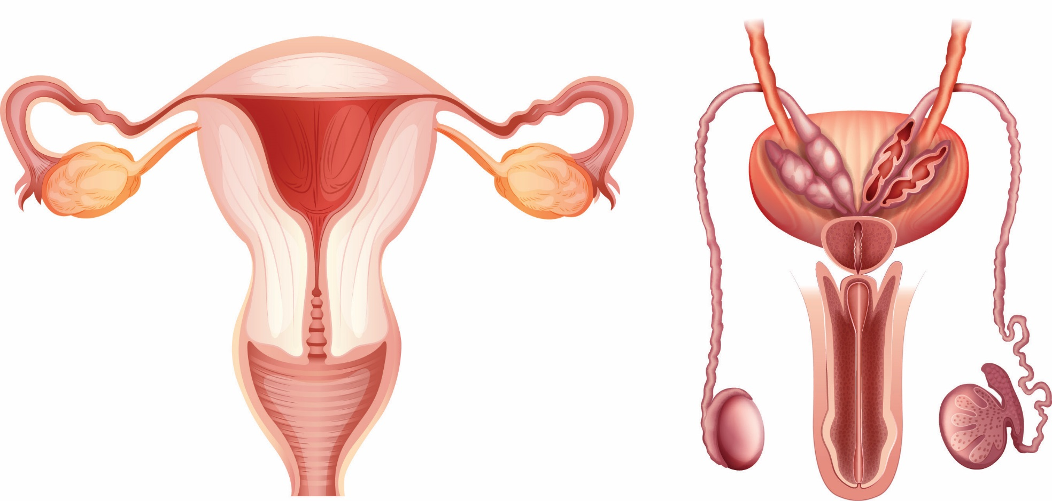
Reproductive Systems

Slide 7
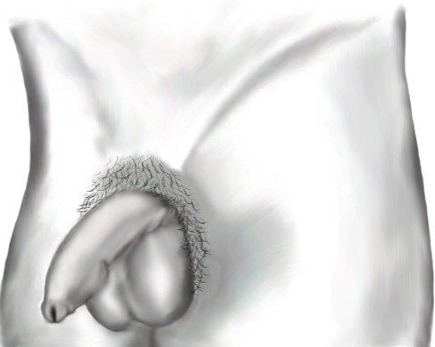
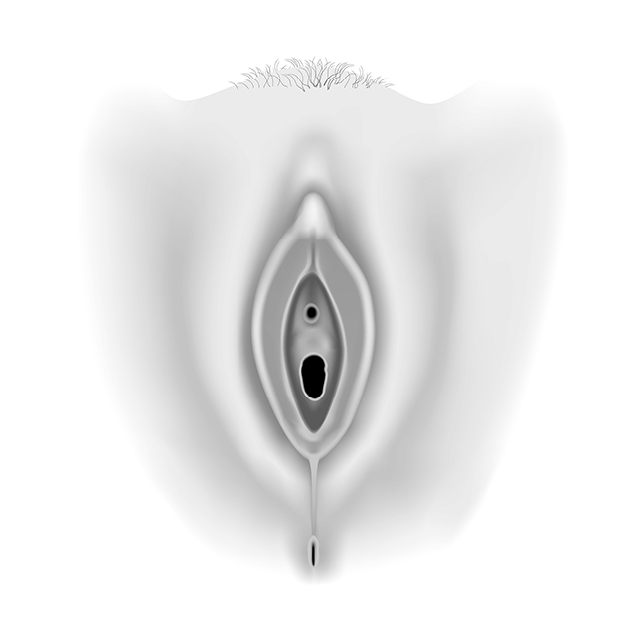
External Genitals
Notes:
To help students understand body and genital diversity, note that not everyone’s genitals look the same, or like what is shown in diagrams and pictures. Variation in size and shape is normal.

Slide 8
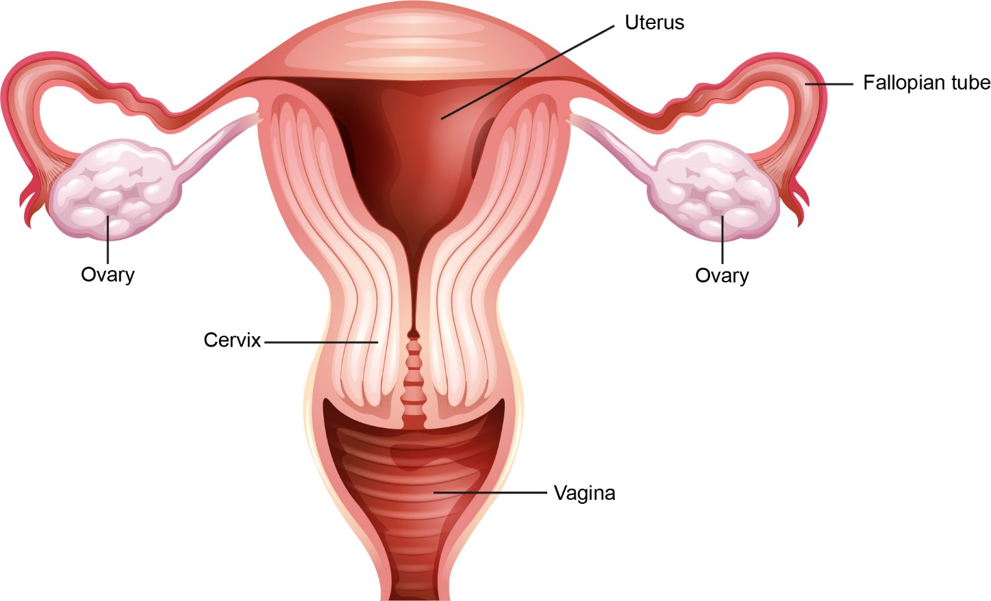
Internal Reproductive Organs

Slide 9
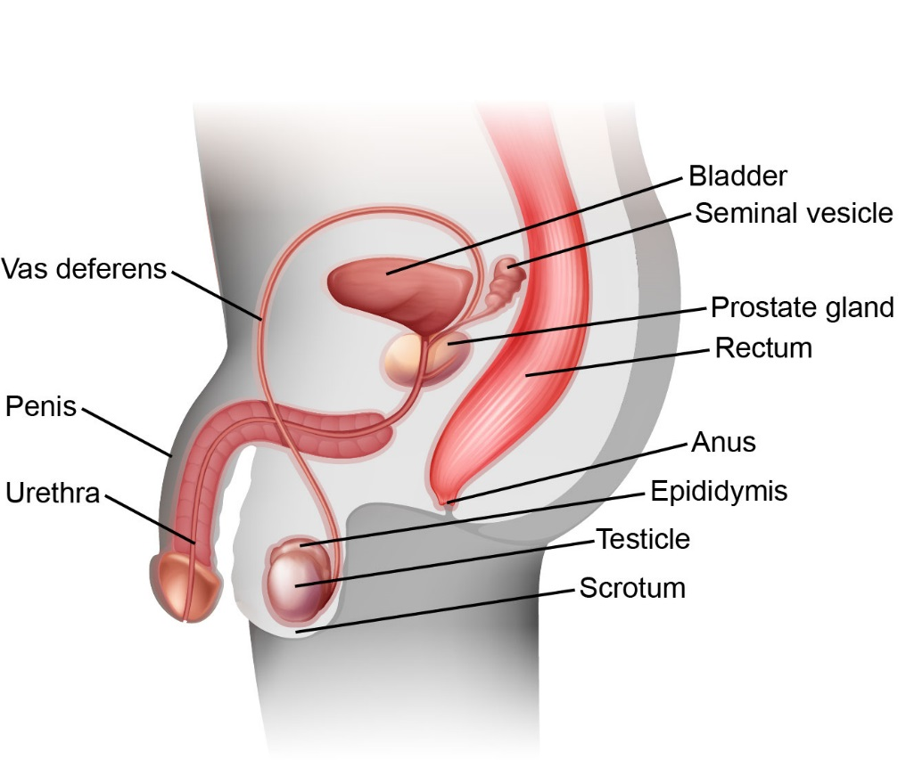
Internal Reproductive Organs

Slide 10
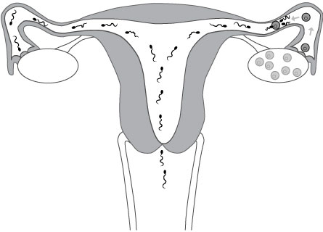
Fertilization

Slide 11
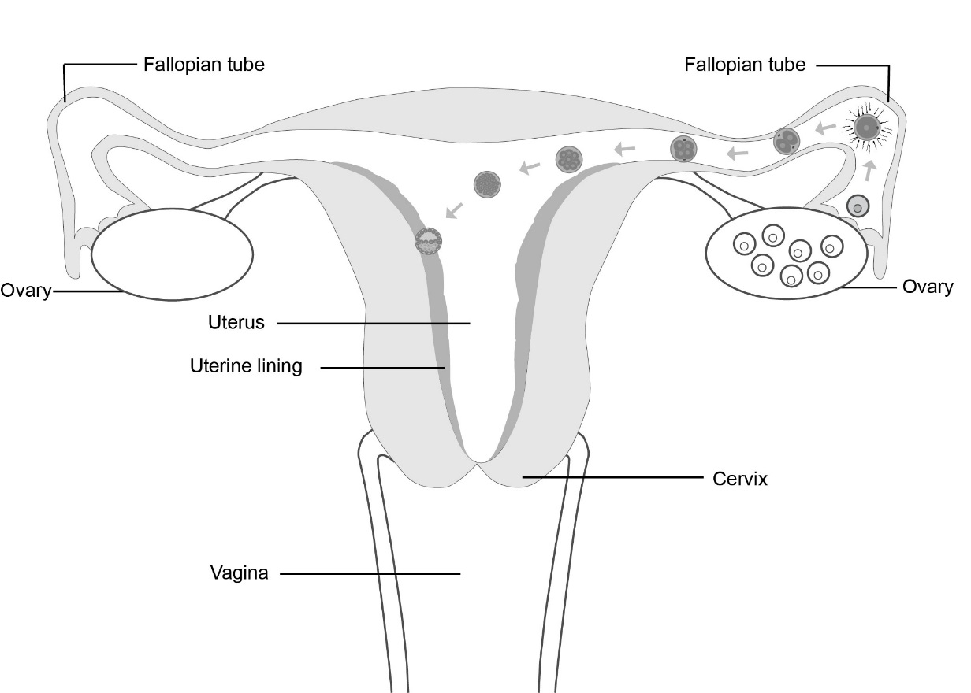
Implantation

Slide 12
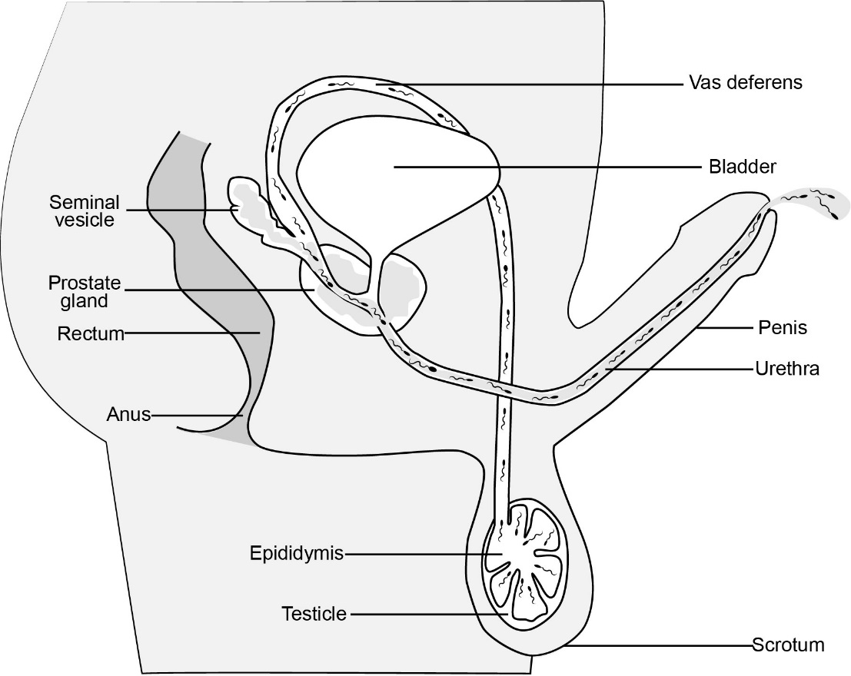
Sperm Production

Slide 13
Types of Abuse
Physical Abuse
Emotional Abuse
Sexual Abuse
Neglect

Slide 14
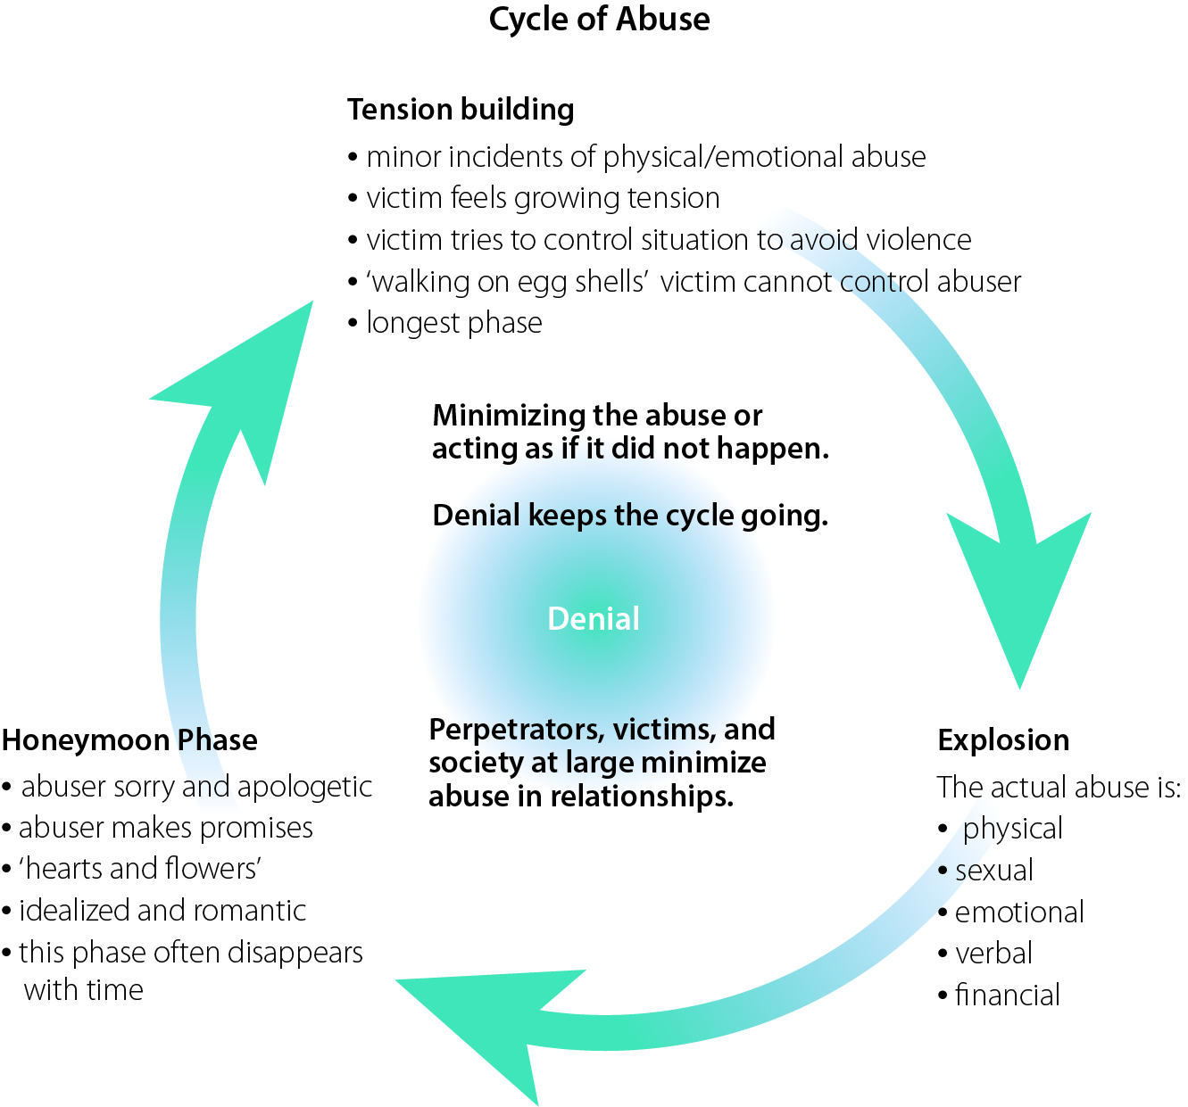
Cycle of Abuse

Slide 15
Consequences of Abuse for the Abused Person
Being abused affects a person now and in the future.
Effects could include:
Impaired brain development
Impaired learning ability and social and emotional skills
Lower achievement in school
Lower language development
Higher risk for heart, lung and liver diseases, obesity, cancer, high blood pressure, and high cholesterol
Low self-esteem, anxiety and depression
Suicide
Smoking, alcoholism and drug abuse

Slide 16
Consequences of Abuse for the Abuser
Abusing someone could have
legal
social
emotional
effects and consequences

Slide 17
Choosing to Disclose
When to Tell
It is never too late to tell someone. You can disclose when you are ready
Remember, the abuse is NEVER your fault. Abuse is NEVER okay
There are people who can help
Be persistent, keep telling

Slide 18
Choosing to Disclose
Who to Tell
A close friend
A trusted adult (a teacher, a friend’s parent, coach, relative, neighbour, or someone else you trust)
If you feel you are in immediate danger, contact the police or call 911

Slide 19
Choosing to Disclose
What Will Happen?
The person you tell should
listen to you
believe you and
will want to help you right away

Slide 20
Supporting a Friend
Important things to tell your friend
It’s not your fault
I believe you
I’m sorry that happened to you
I’m glad you told me
I understand that telling is difficult to do and am proud of you for asking for help
I’ll help you to get help

Slide 21
Supporting a Friend
Important things to do for your friend
Encourage your friend to tell a trusted adult and offer to help your friend tell
Tell a trusted adult about the disclosure
Respect your friend’s privacy. DO NOT tell other friends about the abuse
If nothing happens, tell another trusted adult

Slide 22
Additional anatomy diagrams are available on the Grade 7 page.

