Slide 1
Grade 7
Notes:
The lesson plans use the terms ‘male’ and ‘female’ when referring to biological sex (sex assigned at birth), such as when discussing reproductive anatomy.
People are assigned a sex at birth based on their reproductive anatomy. Sex assigned at birth is independent of gender identity. Gender identity is a person’s internal sense of identity as female, male, both or neither, regardless of their biological sex assigned at birth.

Slide 2
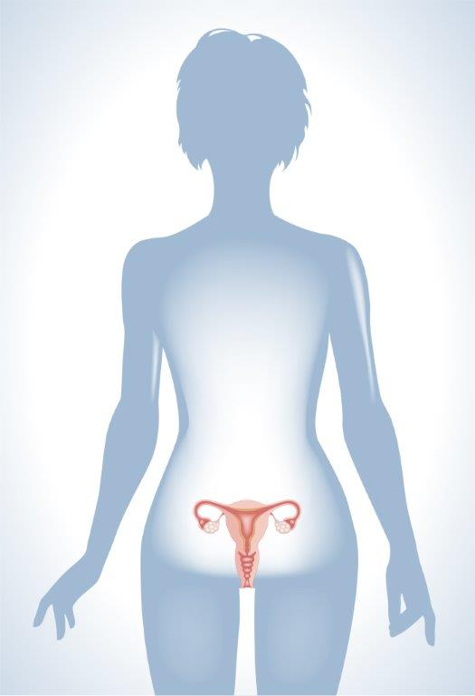
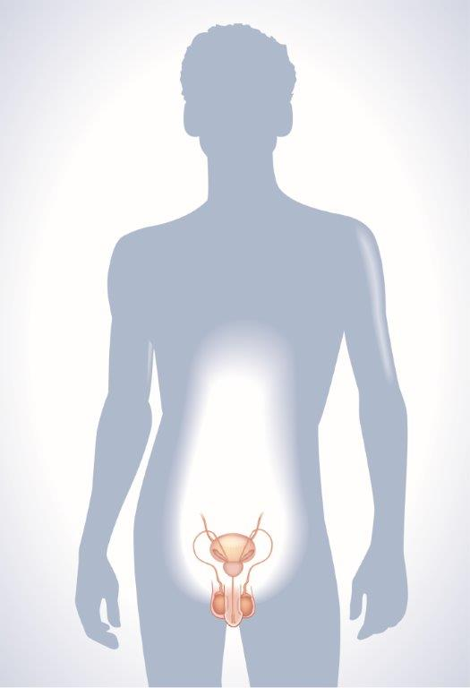
Reproductive Systems
Notes:
This is a good introductory slide so that students can understand the relationship of the reproductive organs to the rest of the body. Show this slide and discuss the difference between internal and external. Then introduce the difference between frontal views and side views of the body. The female reproductive organs are shown primarily using the frontal view, while the male reproductive organs are shown primarily using the side view.
The lesson plans use the terms ‘male’ and ‘female’ when referring to biological sex (sex assigned at birth), such as when discussing reproductive anatomy.
People are assigned a sex at birth based on their reproductive anatomy. Sex assigned at birth is independent of gender identity. Gender identity is a person’s internal sense of identity as female, male, both or neither, regardless of their biological sex assigned at birth.

Slide 3
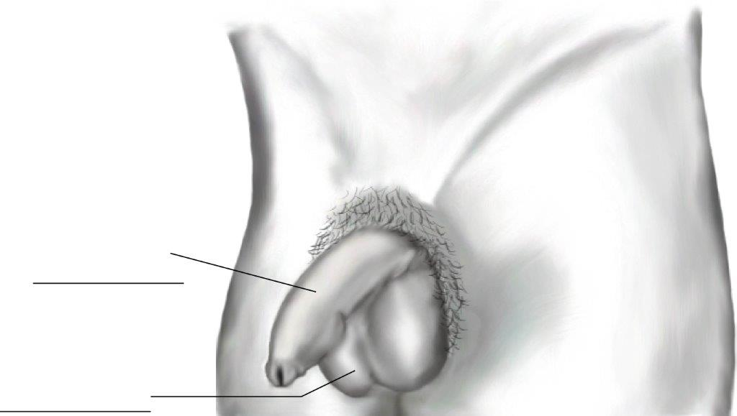
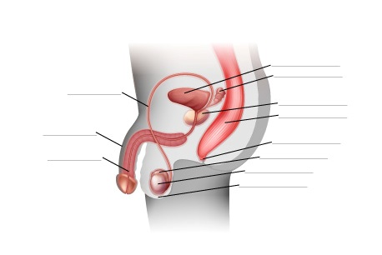
Reproductive System & Genitals
Notes:
To help students understand body and genital diversity, note that not everyone’s genitals look the same, or like what is shown in diagrams and pictures. Variation in size and shape is normal.

Slide 4
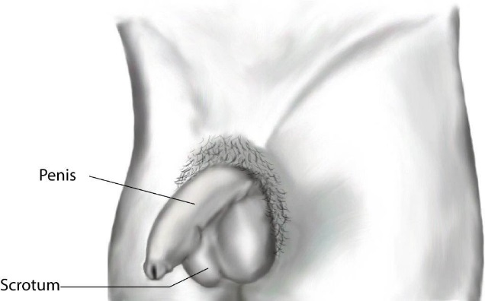
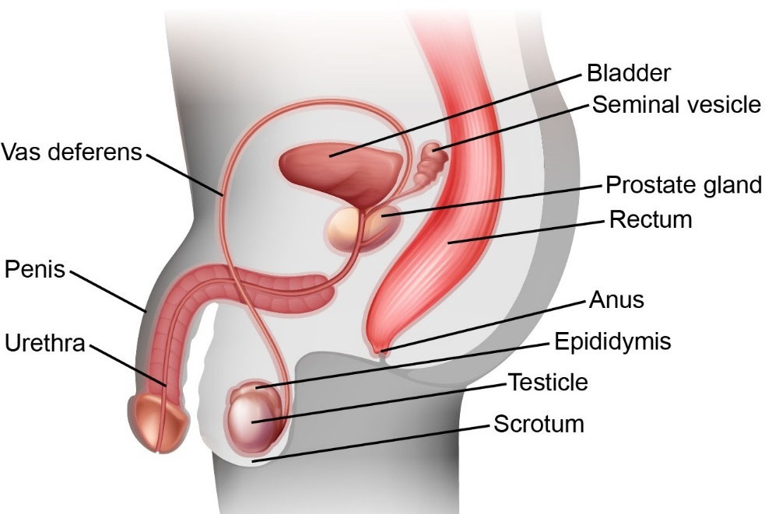
Reproductive System & Genitals

Slide 5
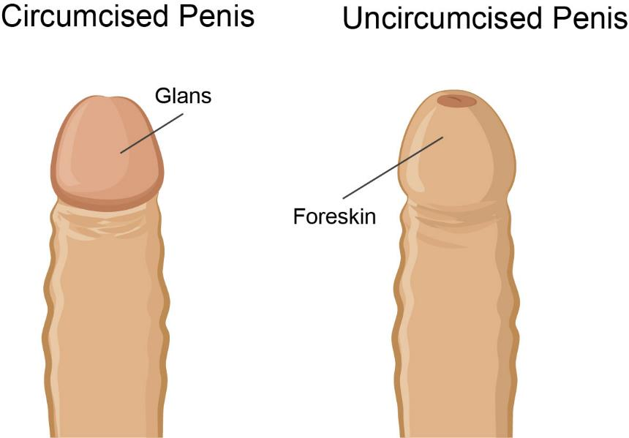
External Genitals

Slide 6
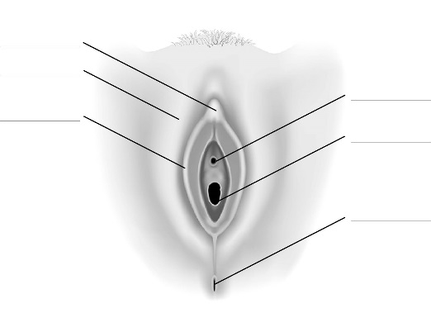
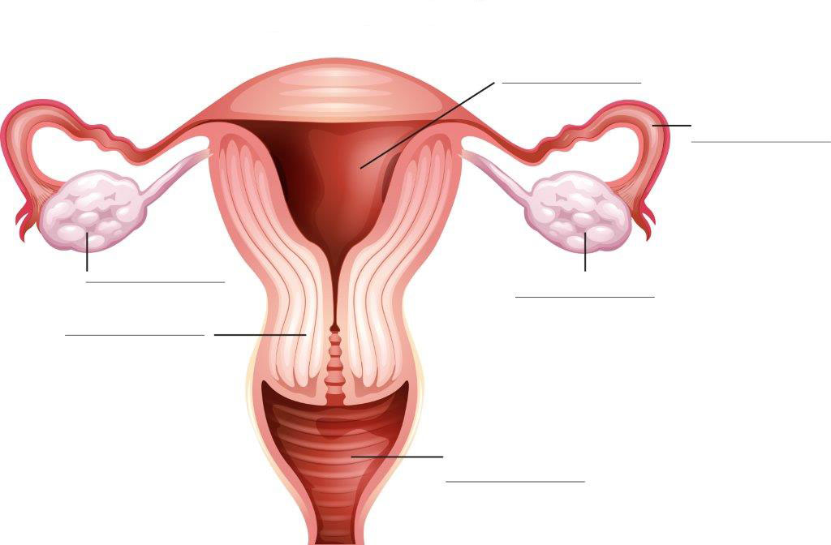
Reproductive System & Genitals
Notes:
To help students understand body and genital diversity, note that not everyone’s genitals look the same, or like what is shown in diagrams and pictures. Variation in size and shape is normal.

Slide 7
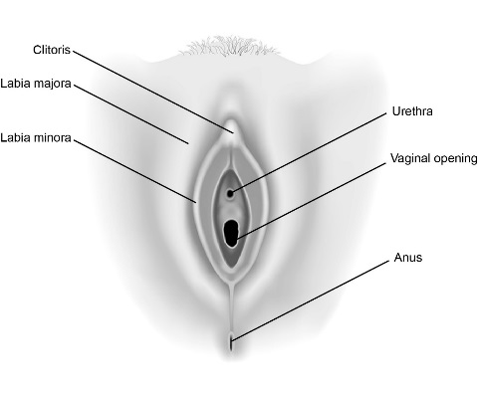
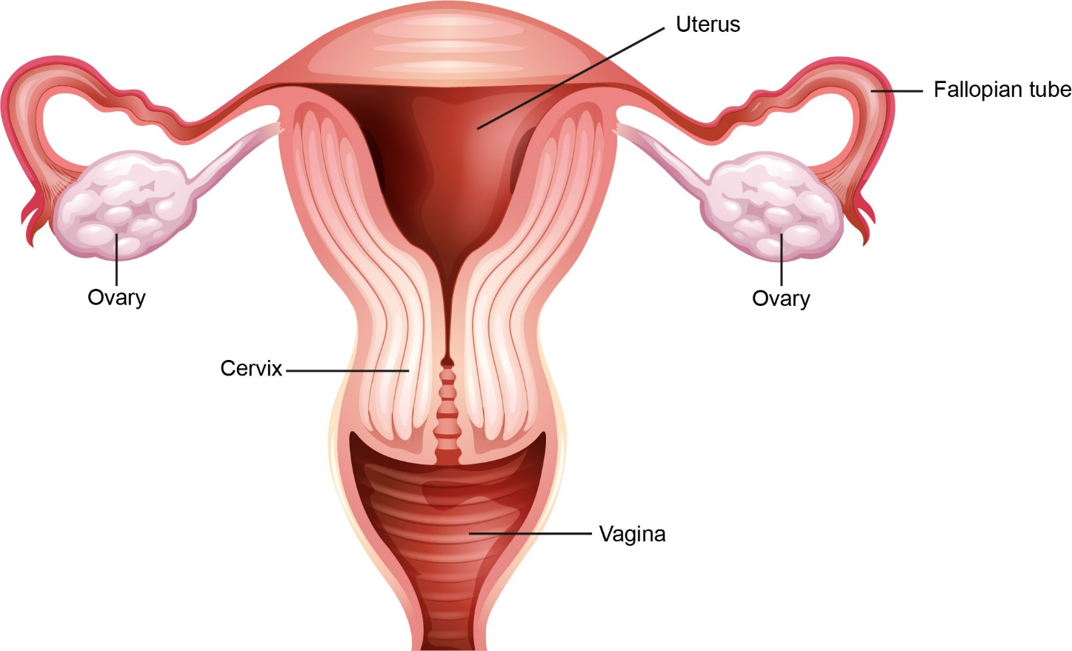
Reproductive System & Genitals

Slide 8
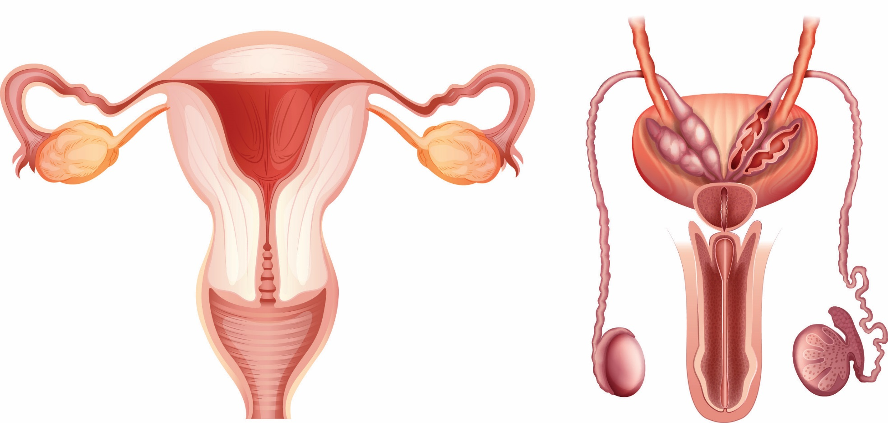
Reproductive Systems

Slide 9
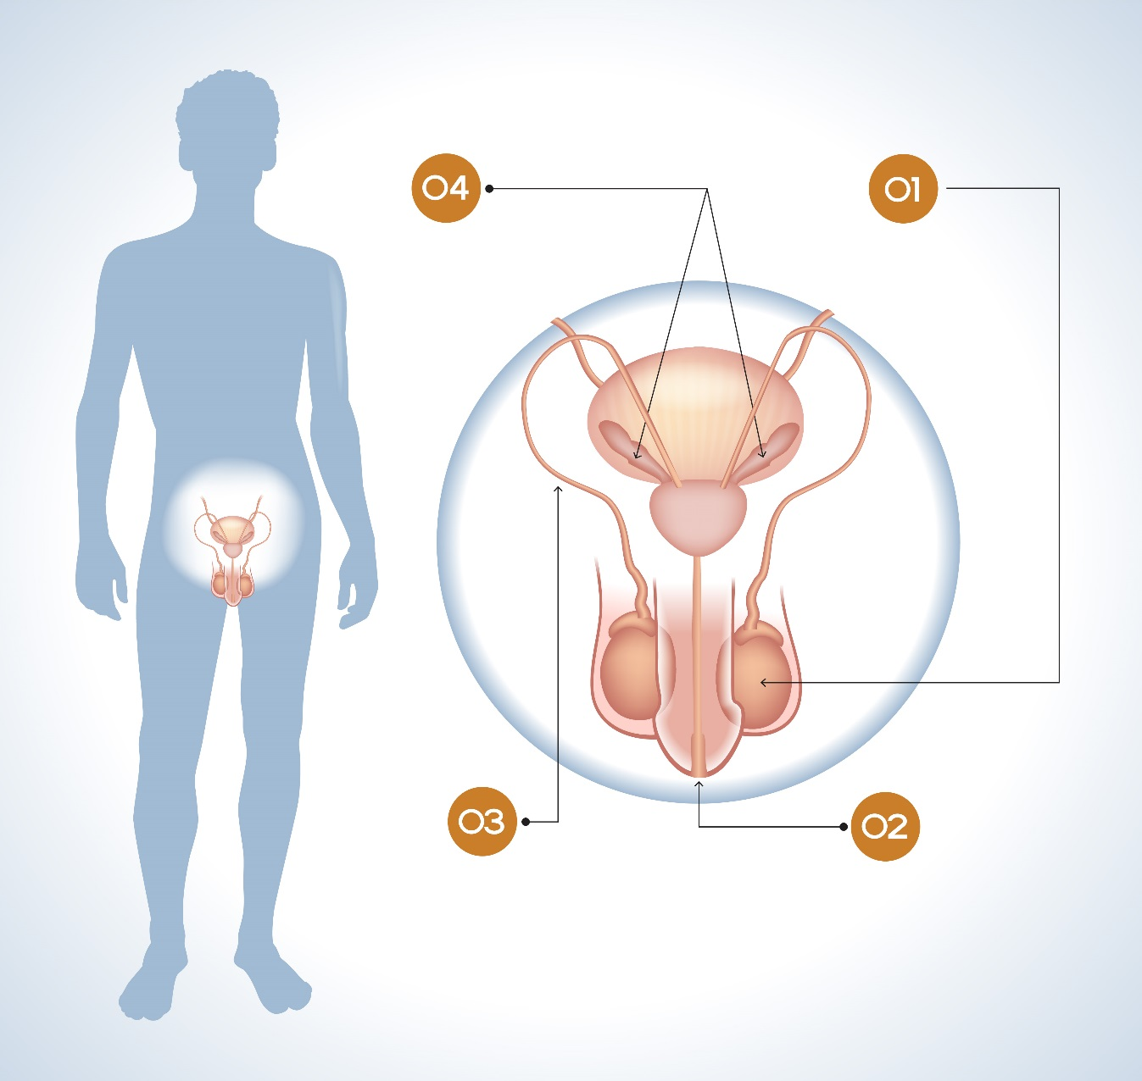
Reproductive System Infographic

Slide 10
Reproductive System Infographic
Seminal Vesicles
Testicle
Vas Deferens
Penis

Slide 11
Reproductive System Infographic
Seminal Vesicles: produce and store seminal fluid to mix with sperm to make semen
Testicle: where sperm are made, protected inside scrotum
Vas Deferens: long tube to transport sperm from testicles to urethra
Penis: contains urethra, can become erect

Slide 12
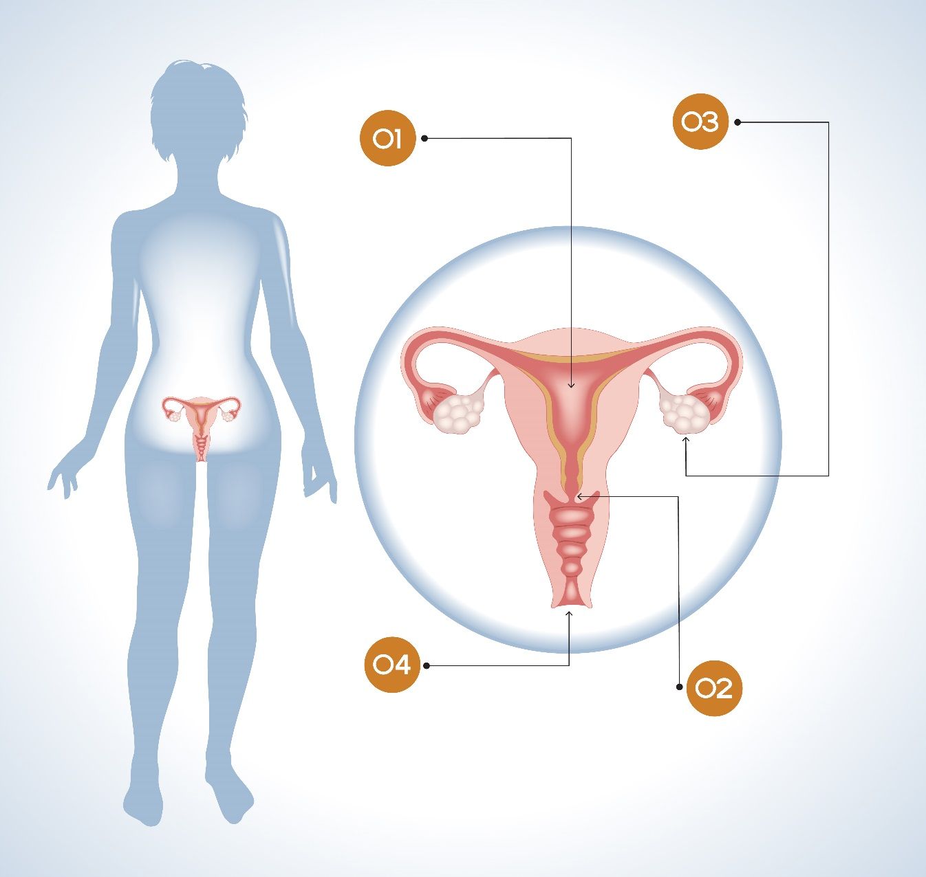
Reproductive System Infographic

Slide 13
Reproductive System Infographic
Ovary
Uterus
Vagina
Cervix

Slide 14
Reproductive System Infographic
Uterus: where the developing baby grows, sheds lining during menstruation
Ovary: releases one egg each month from alternating sides
Vagina: passageway to the uterus, how the baby gets out during birth
Cervix: bottom of the uterus that opens into the vagina

Slide 15
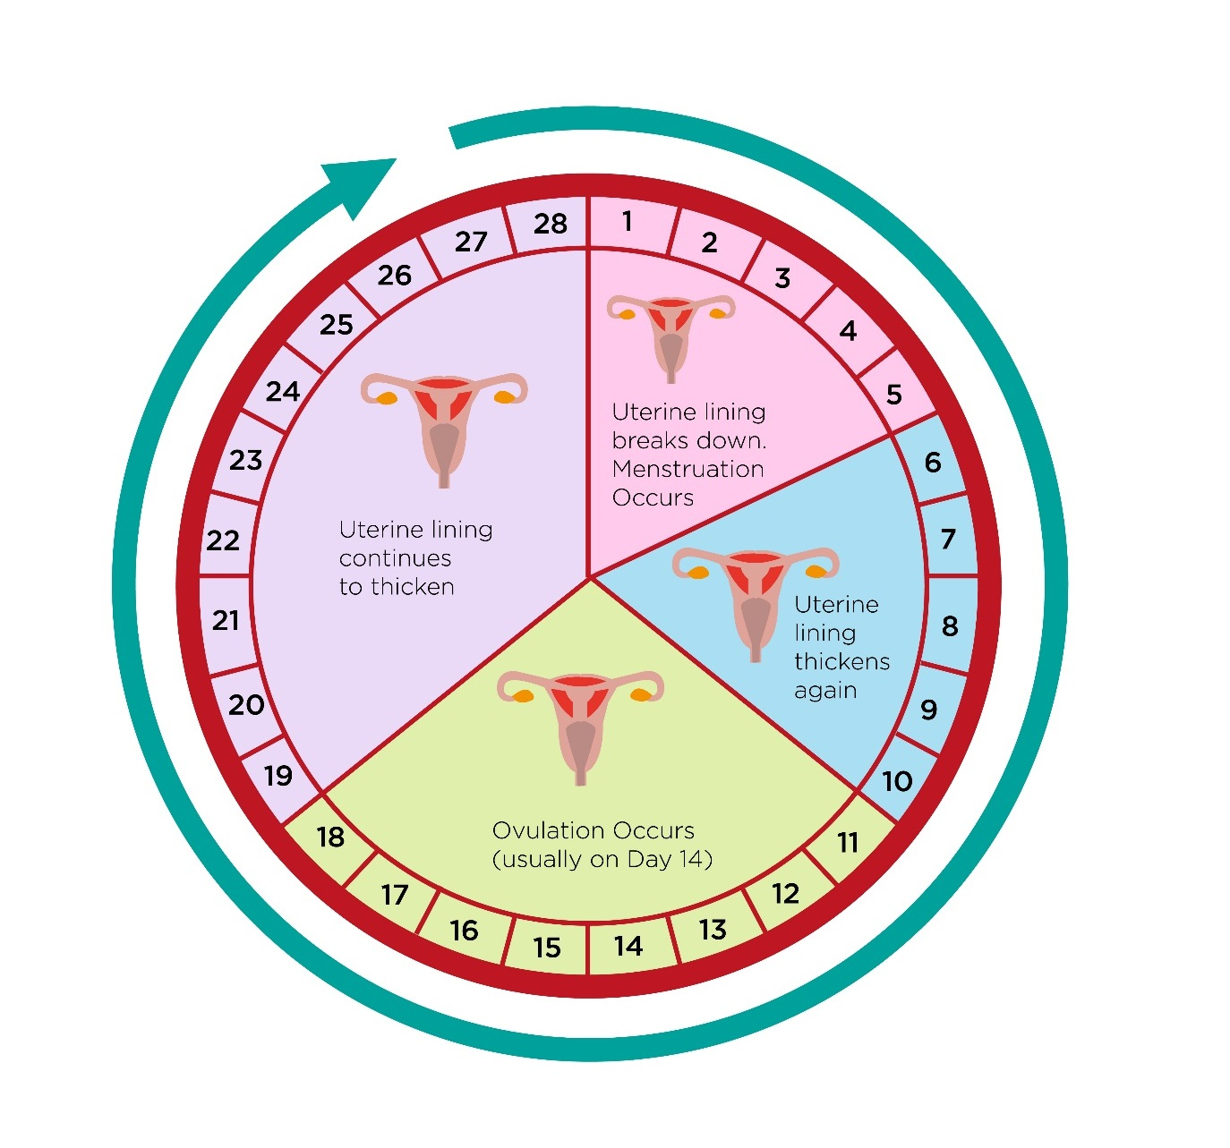
Menstrual Cycle
This diagram shows a menstrual cycle of 28 days, which is an average. Cycles can vary between 24-38 days long.

Slide 16
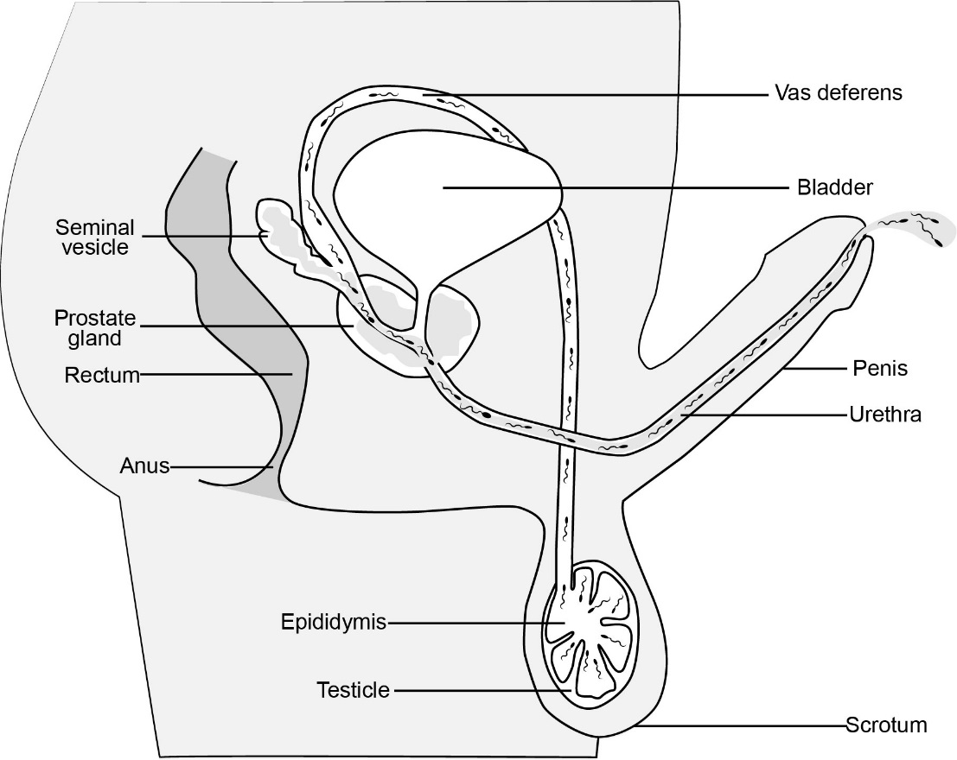
Sperm Production

Slide 17
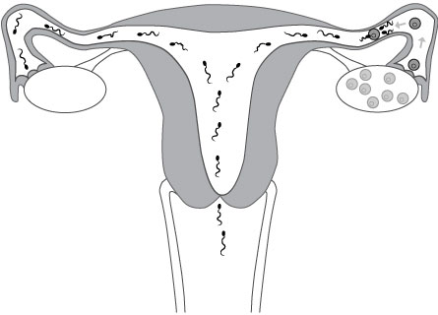
Fertilization

Slide 18
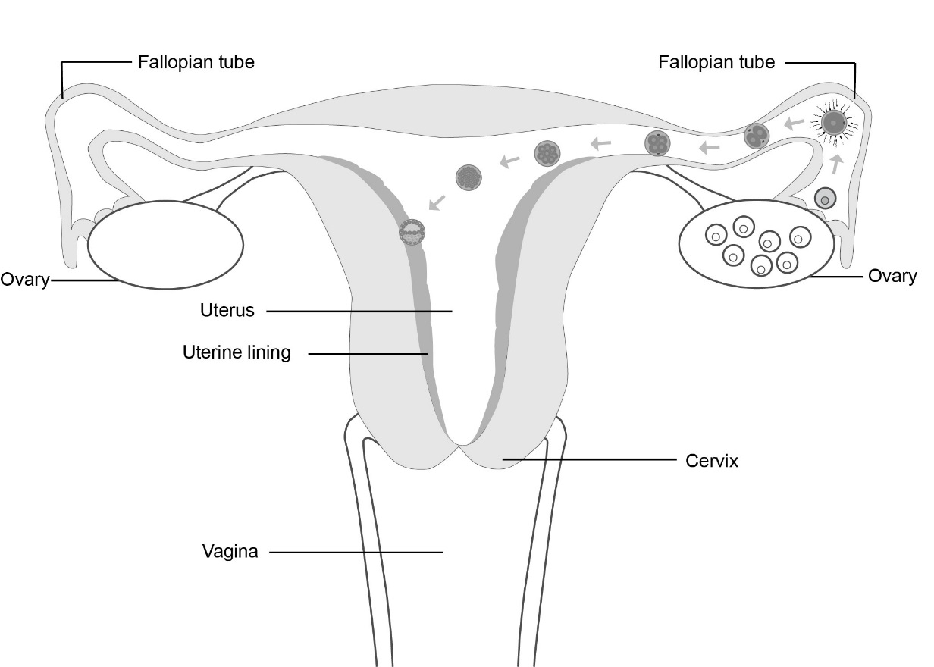
Implantation

Slide 19
Additional Resources
Additional diagrams are available on the Grade 5 and Grade 6 pages.

