Slide 1
Understanding My Body
© 2024

Slide 2
Body Parts
Notes:
To help students understand body and genital diversity, note that not everyone’s genitals look the same, or like what is shown in diagrams and pictures. Variation in size and shape is normal.

Slide 3
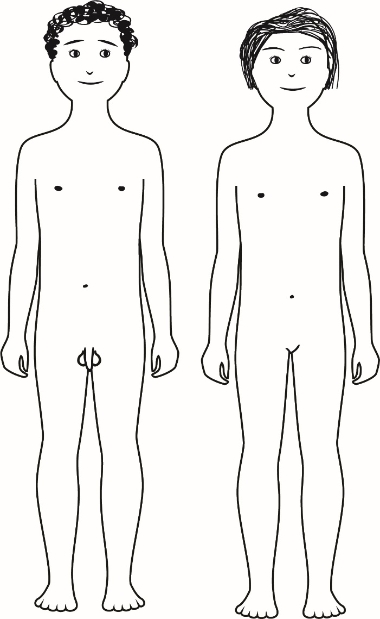
Body Parts
Notes:
An example to show a simple way to draw differences in external genitals.

Slide 4
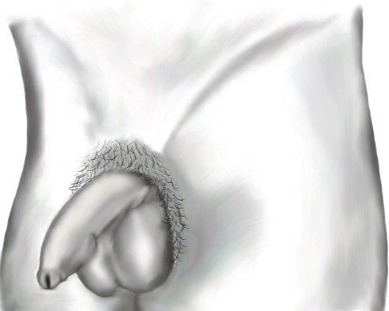
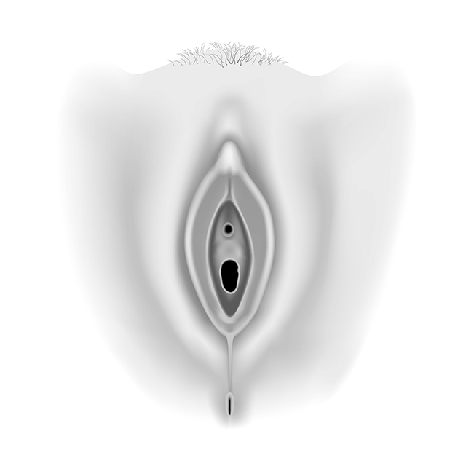
External Genitals
Notes:
To help students understand body and genital diversity, note that not everyone’s genitals look the same, or like what is shown in diagrams and pictures. Variation in size and shape is normal.

Slide 5
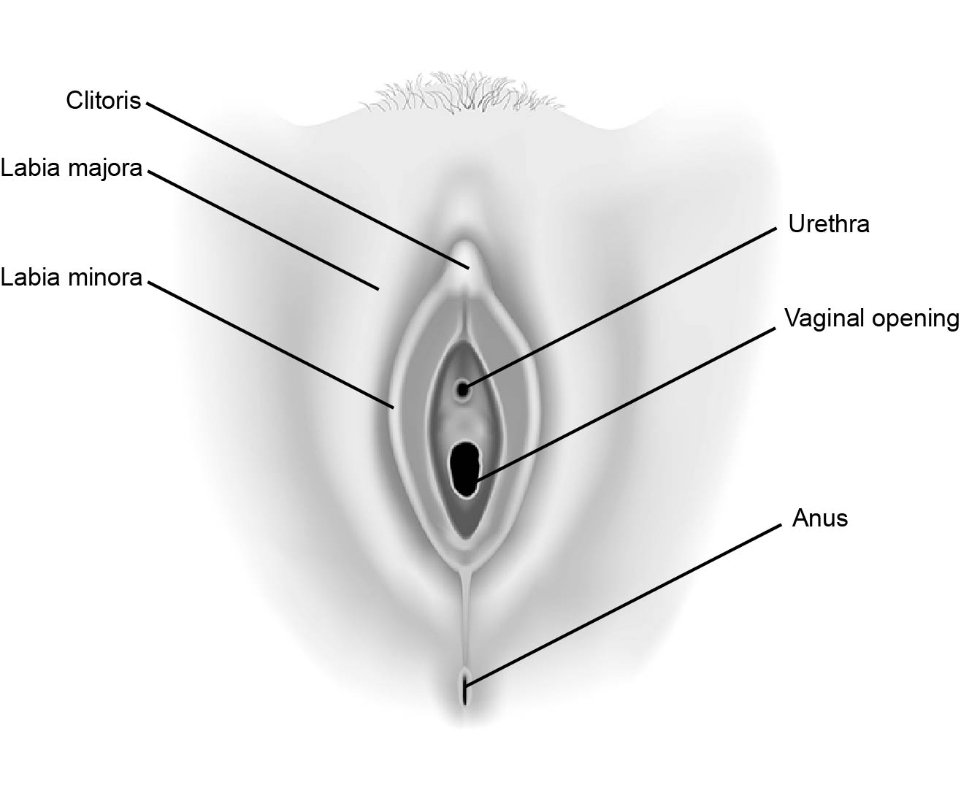
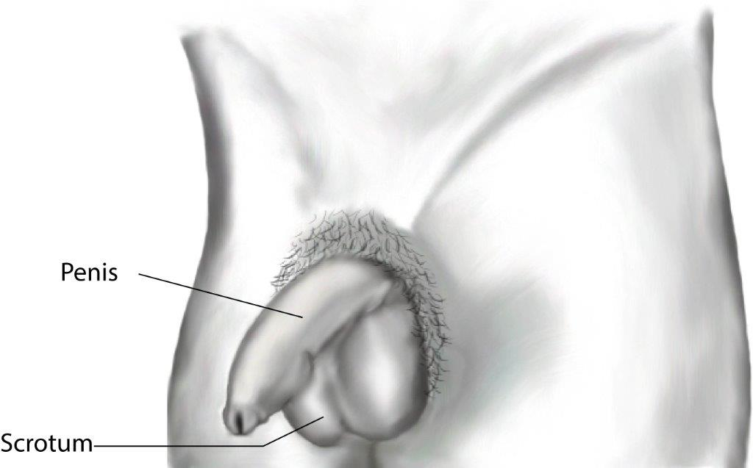
External Genitals
Notes:
To help students understand body and genital diversity, note that not everyone’s genitals look the same, or like what is shown in diagrams and pictures. Variation in size and shape is normal.

Slide 6
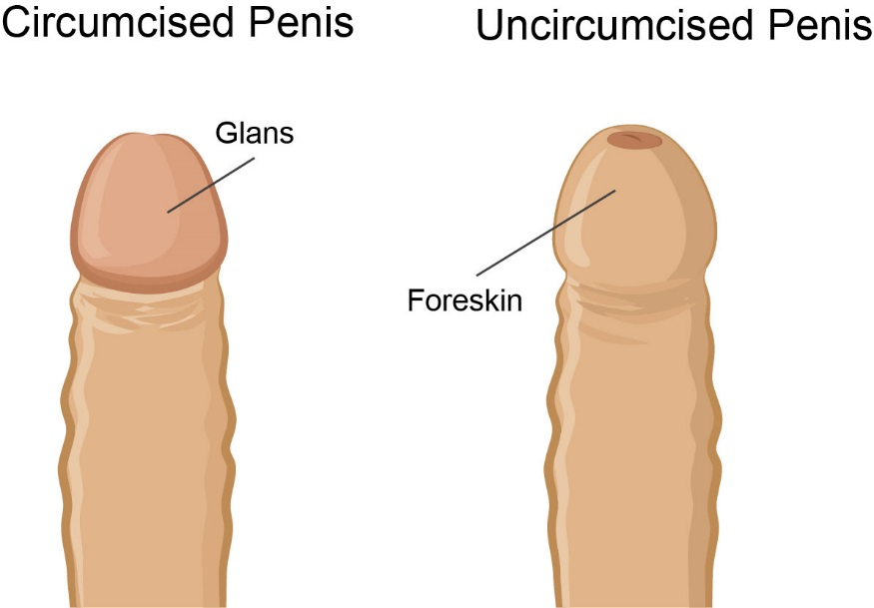
External Genitals
Notes:
Circumcision is a procedure to remove the foreskin from the penis. It is usually done soon after birth by a doctor or trained religious person. Some people are circumcised and some are not. It doesn’t affect the function of the penis. There is not usually a medical or health reason for circumcision.

Slide 7
Reproduction, Pregnancy and Birth
© 2024

Slide 8
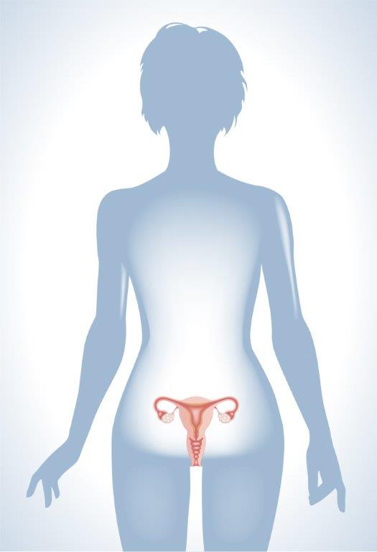
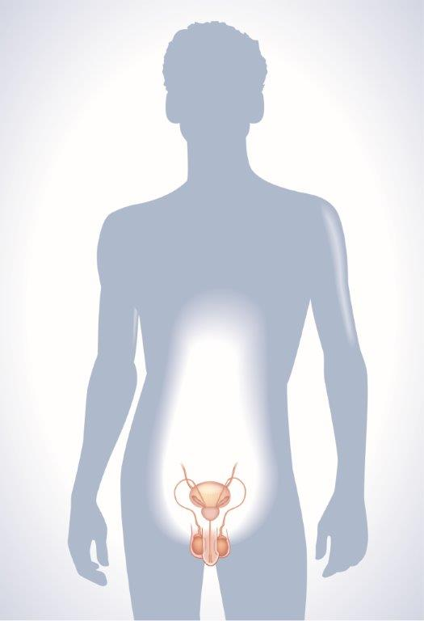
Reproductive Systems
Notes:
This is a good introductory slide so that students can understand the relationship of the reproductive organs to the rest of the body. Show this slide and discuss the difference between internal and external. Then introduce the difference between frontal views and side views of the body. The egg-producing reproductive organs are shown primarily using the frontal view, while the sperm-producing reproductive organs are shown primarily using the side view.
A person’s sex can be assigned at birth as male or female. Some people are intersex (the reproductive, sexual or genetic biology of a person is unclear, not exclusively male or female or otherwise does not fit within traditional definitions of male or female). Assigned sex is independent of gender.
Gender identity is a person’s internal sense of identity as girl/woman, boy/man, fluid among genders or no gender (regardless of what sex they were assigned at birth).

Slide 9
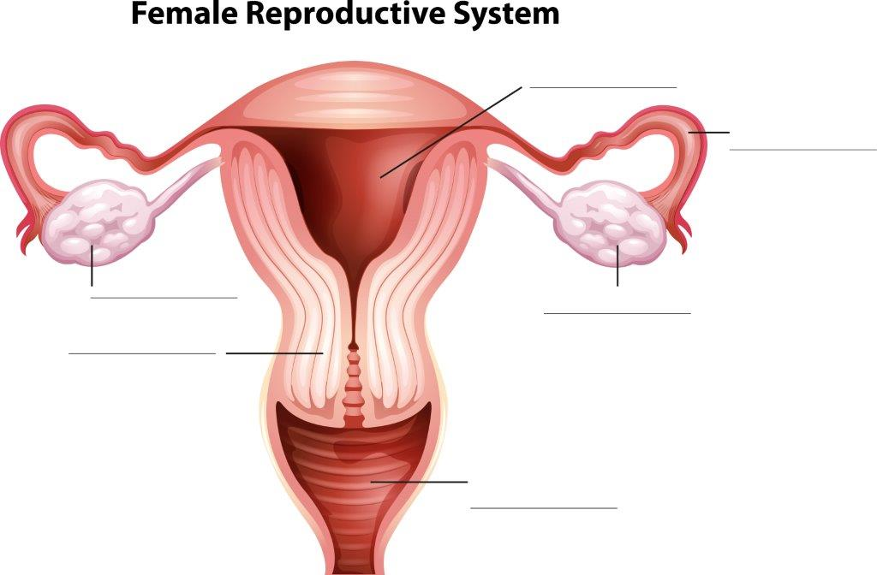
Reproductive Systems

Slide 10
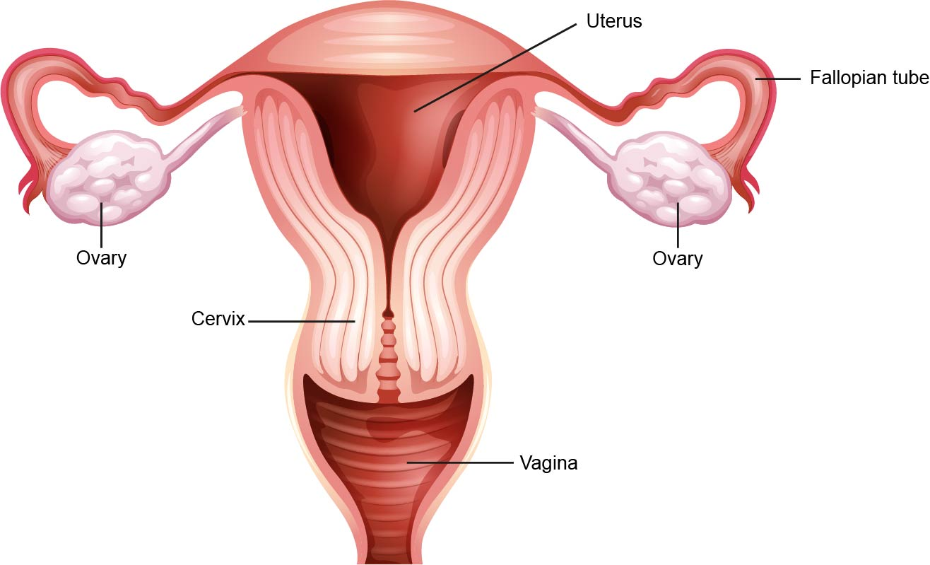
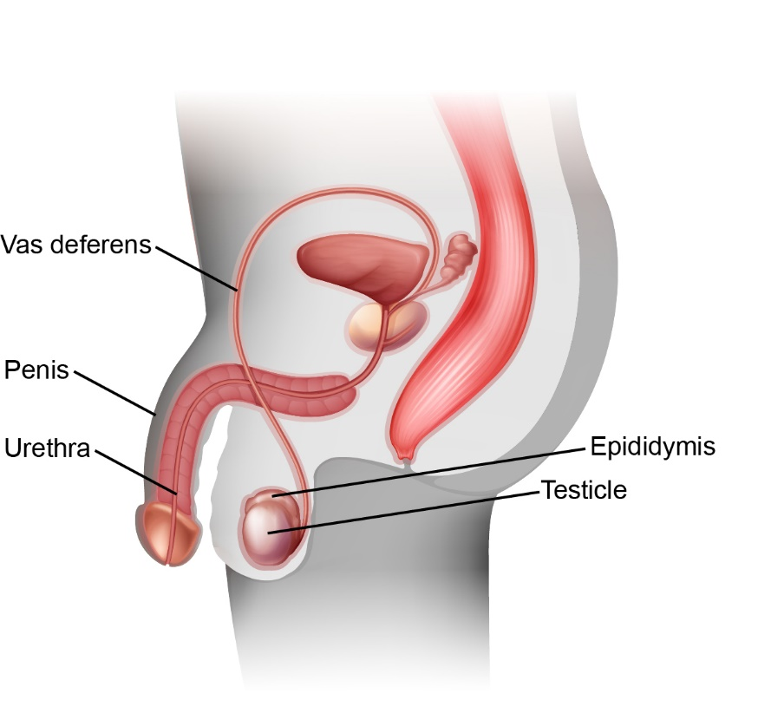
Reproductive Systems

Slide 11
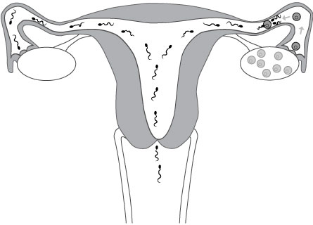
Fertilization
Notes:
During sex, the erect penis is inserted into the vagina. Sperm are ejaculated into the vagina and begin swimming up past the cervix, through the uterus and into the fallopian tubes. The tail of each sperm cell acts as a propeller to move the sperm forward. The first sperm will enter the fallopian tube minutes after ejaculation, and can live in the fallopian tubes/uterus for up to five days. If the sperm encounter an egg in the fallopian tube, each sperm cell will attempt to penetrate the egg. Only one sperm will succeed in penetrating the egg, which is called fertilization. Once one sperm has penetrated the egg, the outer membrane of the egg changes and prevents fertilization by any other sperm.

Slide 12
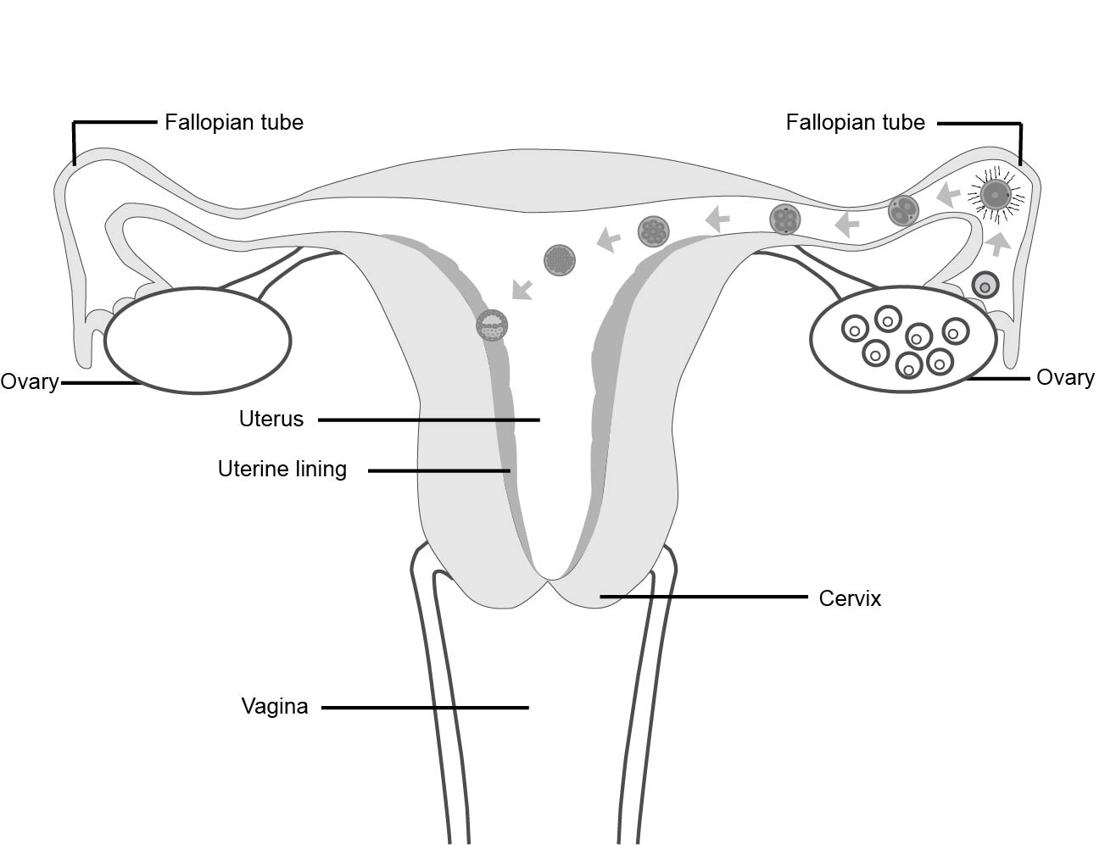
Implantation
Notes:
After the sperm cell and the egg unite, the fertilized egg is called a zygote. The zygote travels down the rest of the fallopian tube and into the uterus. It also begins dividing, so that the single fertilized cell becomes two cells, the two cells become four, etc. About 5-7 days after fertilization, the zygote implants into the lining of the uterus, creating a pregnancy. The cells are now called an embryo.
If more than one egg is released at the same time, each egg can be fertilized by a different sperm. This will result in fraternal twins. If a zygote divides into two distinct entities, this will result in identical twins. Why the zygote divides into two at this stage is unknown. About 3% of births in Canada are twins, triplets, or more.

Slide 13
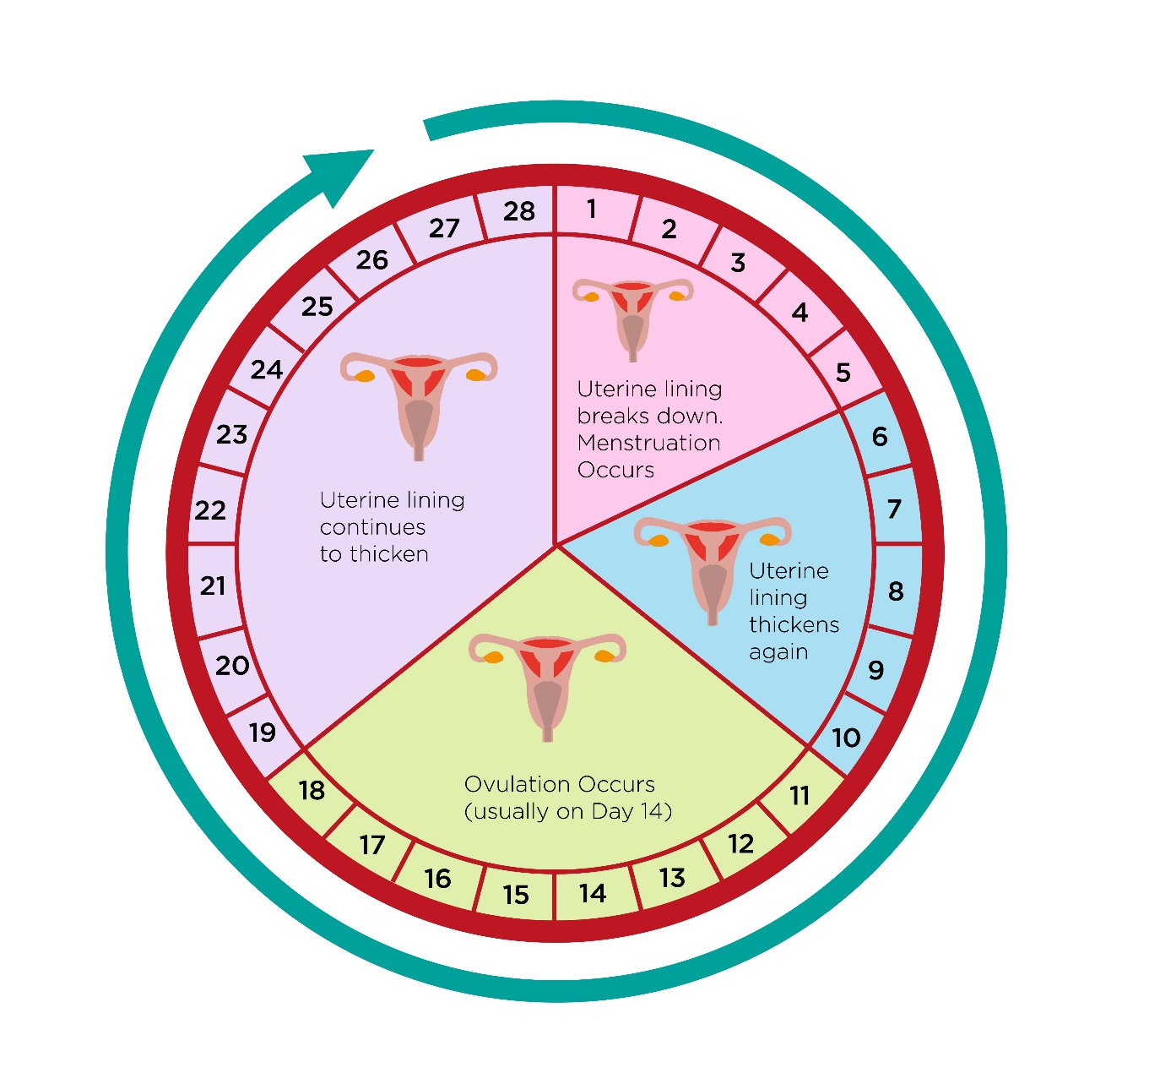
Menstrual Cycle
This diagram shows a menstrual cycle of 28 days, which is an average. Cycles can vary between 24-38 days long.
Notes:
Menstruation usually begins around the ages of 9 to 15. Every person has their own internal clock that determines when the events of puberty begin.

Slide 14
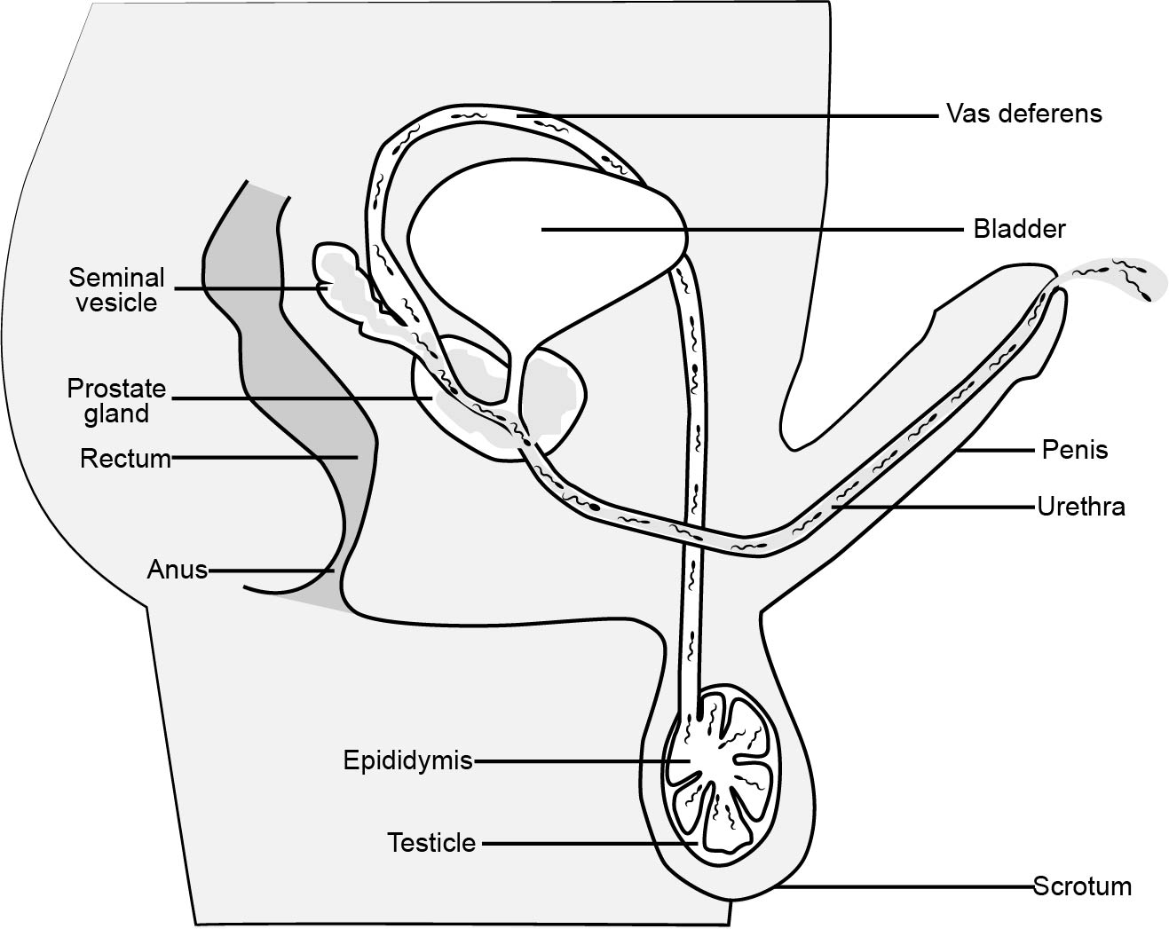
Sperm Production
Notes:
Each sperm is very small; there are over 300 million sperm in 5 ml of semen.
Millions of sperm are made every day in the testicles and stored in the epididymis. Sperm that are not released through ejaculation are reabsorbed by the body.
The sperm travel up the vas deferens and mix with fluid from the seminal vesicle and prostate to form whitish sticky fluid called semen.

