Slide 1
CALM

Slide 2
CALM
Relationships

Slide 3
Healthy Relationships
In a healthy relationship, your partner will:
Listen to you and take your feelings and ideas seriously
Talk openly and honestly with you about what matters to them
Respect you, and say good things to you and about you
Enjoy spending time with you, and show it whether alone with you or in a group

Slide 4
Healthy Relationships
In a healthy relationship, your partner will:
Trust you, and earn your trust by keeping your private information private
Encourage you to enjoy the activities and people that matter to you
Accepts your limits about sexual activity, every time

Slide 5
Unhealthy Relationships
Believing one person has more rights than the other
Shouting or yelling when you are angry at your partner
Using the silent treatment
Pestering your partner until you get what you want
Pouting to get what you want
Excessive calling, texting or emailing

Slide 6
Abusive Relationships
Questions that Help Identify an Abusive Relationship
Are you frightened by your partner’s temper?
Are you afraid to disagree?
Are you constantly apologizing for your partner’s behaviour, especially when they treated you badly?
Do you have to justify everything you do, every place you go, or every person you see to avoid your partner’s anger?
Does your partner put you down, but then tell you that they love you?

Slide 7
Abusive Relationships
Questions that Help Identify an Abusive Relationship
Have you ever been hit, kicked, shoved, or had things thrown at you?
Do you avoid seeing friends or family because of your partner’s jealousy?
Are you afraid to break up because your partner has threatened to post personal photos of you online?
Have you been forced into having sex when you didn’t want to?
Are you afraid to break up because your partner has threatened to hurt you or themselves?

Slide 8
Types of Communication
Assertive
Stand up for their rights without denying other people theirs
Respect themselves as well as others
Ask for what they want in a straightforward manner
Express their emotions (both positive and negative) in a healthy manner

Slide 9
Types of Communication
Passive
Give in and say yes even when they don’t want to
Put the feelings and concerns of others before their own
Does not share/say their concerns

Slide 10
Types of Communication
Aggressive
Think of themselves first, at the expense of others
Dominate others
Use threats or force

Slide 11
Communication Styles

Slide 12
Safety Planning for Teens
Tips if you are in or leaving an abusive relationship:
Stay in touch with friends and involved in activities.
Keep important phone numbers with you at all times.
Consider telling your parents, teachers or other trusted adults.
Set up a code word with friends or parents for danger.

Slide 13
Safety Planning for Teens
Tips if you are in or leaving an abusive relationship:
Consider talking to police and/or a shelter about your situation.
Try not to be alone with your partner.
When with your partner, keep in mind warning signs that tell you when things may become abusive.
If you think you are in danger, LEAVE!

Slide 14
Safety Planning for Teens
Tips if you are in or leaving an abusive relationship:
Make sure someone knows where you are and when you’ll be home.
Always have your cell phone close by or know where the nearest phone is.
If you decide to break up, do it in a public place. Have friends or parents wait for you near by. Take your cell phone with you if possible.

Slide 15
If You Think Your Friend Is Being Abused
Listen to what your friend has to say. Believe them.
Let your friend know why you are concerned. Be specific. Refer to incidents you have personally witnessed instead of what you have heard from others.
Remind your friend that jealousy and possessiveness do not equal love.

Slide 16
If You Think Your Friend Is Being Abused
Don’t tell your friend that it is wrong if they choose to stay in the relationship. Keep listening, talking and challenging your friend to think about what to do.
If your friend chooses not to leave, help create a safety plan.
Continue to be a friend even in the times when you feel frustrated by decisions or actions. Your friend needs you!

Slide 17
If You Think Your Friend Is Being Abused
Tell your friend, “You are not to blame.” Remind them it is the partner who is choosing this behaviour.
Mention other people your friend might talk to: a counsellor, a teacher, another adult they trust or a community agency.
Talk to a trusted adult for help and support.

Slide 18
If You Think Your Friend Is Being Abusive
Be specific about what you say and how it made you feel. Take a stand. Remember early signs of abuse may include jealousy or possessiveness.
Challenge your friend’s stereotyping and putdowns of people. Don’t laugh at jokes or comments that make fun of people.

Slide 19
If You Think Your Friend Is Being Abusive
Talk about the consequences of violence. Abusive behaviour builds fear, not love. Physical and sexual assault are against the law.
Talk to a trusted adult for help and support.

Slide 20
Resources
Kids Help Phone 1-800-668-6868 or kidshelpphone.ca
Alberta One Line for Sexual Violence 1-866-403-8000
Association of Alberta Sexual Assault Services www.aasas.ca
Call Health Link at 811

Slide 21
CALM
STBBIs

Slide 22
Video Demonstration Links
Condom
Vaginal Condom
Dental Dam

Slide 23
Effectiveness
Method | STI Protection | Pregnancy Prevention (Typical use) *
Abstinence |  | 
Injection |  | 
Pill/ Patch/ Ring |  | 
Implant |  | 
Condom |  | 
Emergency Contraception |  | **
IUD |  | 
Vaginal Condom |  | 
Withdrawal |  | 
No Method |  | 
= None = Fair = Good   = Excellent
Notes:
*Some birth control methods have much higher effectiveness ratings in ‘perfect use’ conditions. For a comparison of the difference between perfect and typical use, see the Birth Control Effectiveness Graph.
** The contraceptive effectiveness rate for emergency contraception depends on what kind is used, and how soon after unprotected sex it is used. See the Health Information Sheet on emergency contraception for more information.

Slide 24
CALM
Birth Control

Slide 25
Birth Control Effectiveness
Notes:
Effectiveness rate for typical use refers to how effective each method is at preventing pregnancy during actual use including incorrect or inconsistent use.

Slide 26
Birth Control Effectiveness
Notes:
Effectiveness rate for typical use refers to how effective each method is at preventing pregnancy during actual use including incorrect or inconsistent use.
Effectiveness rate for perfect use refers to how effective each method can be at preventing pregnancy when the user follows the exact directions all the time.
Fertility Awareness Based Methods (FABs) help people understand how to prevent a pregnancy by not having sex during the fertile time. There are many different methods, including the calendar rhythm method, basal body temperature, cervical mucous and symptothermal method. These methods include some form of tracking menstrual cycles, charting body temperature or observing changes in cervical mucous to help a person determine days they are less likely to get pregnant. FABs require a lot of practice to learn how to use consistently and can be difficult because not all menstrual cycle are regular.
Spermicides includes vaginal contraceptive film, foams, gels, creams, and vaginal suppositories.

Slide 27
Reproductive Systems

Slide 28
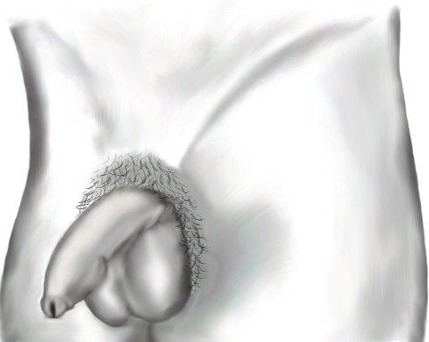
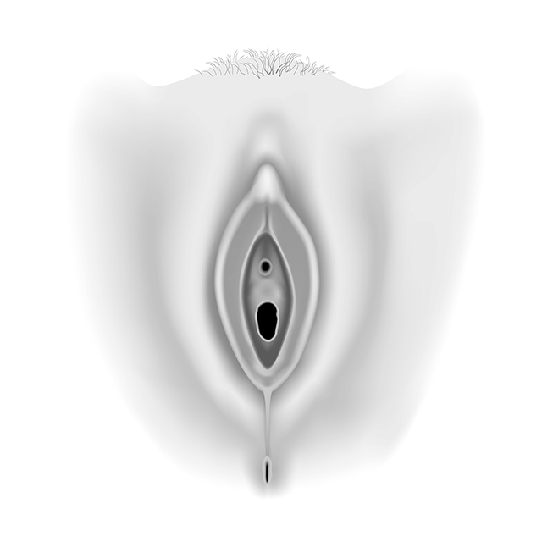
External Genitals

Slide 29
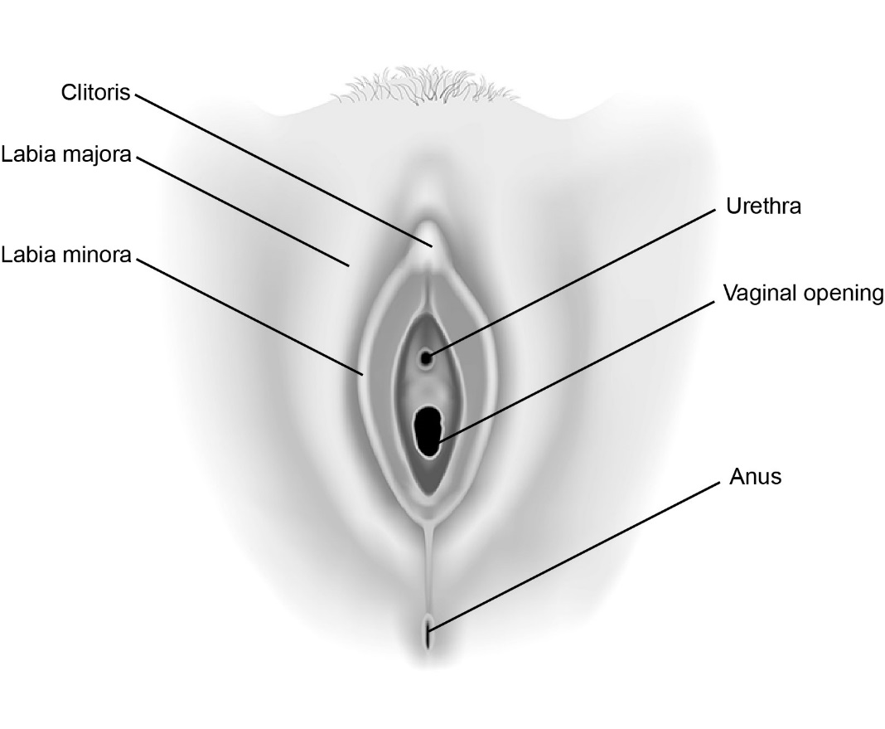
External Genitals

Slide 30
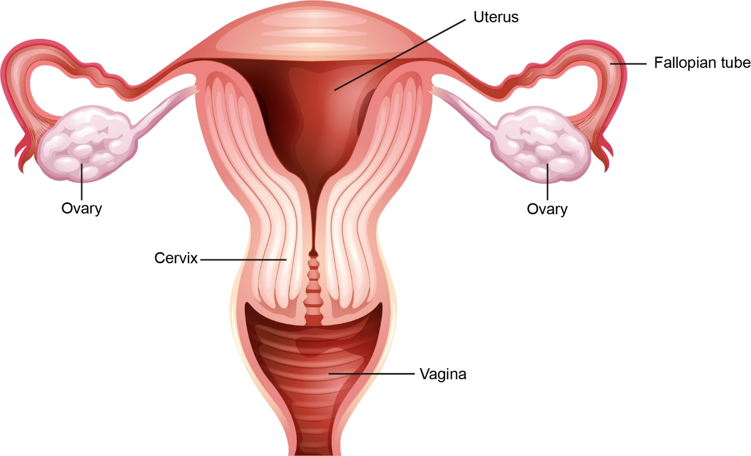
Internal Reproductive Organs

Slide 31
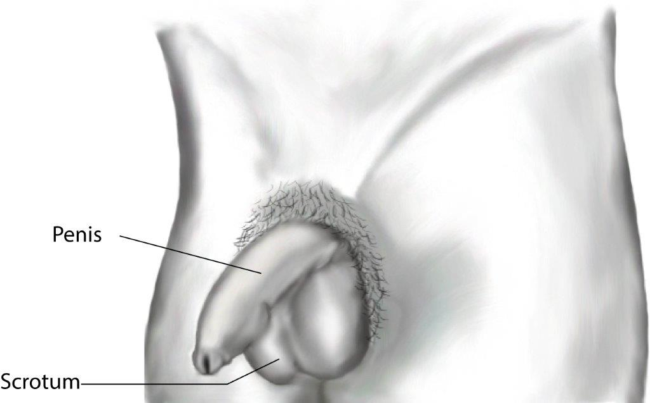
External Genitals

Slide 32
External Genitals

Slide 33
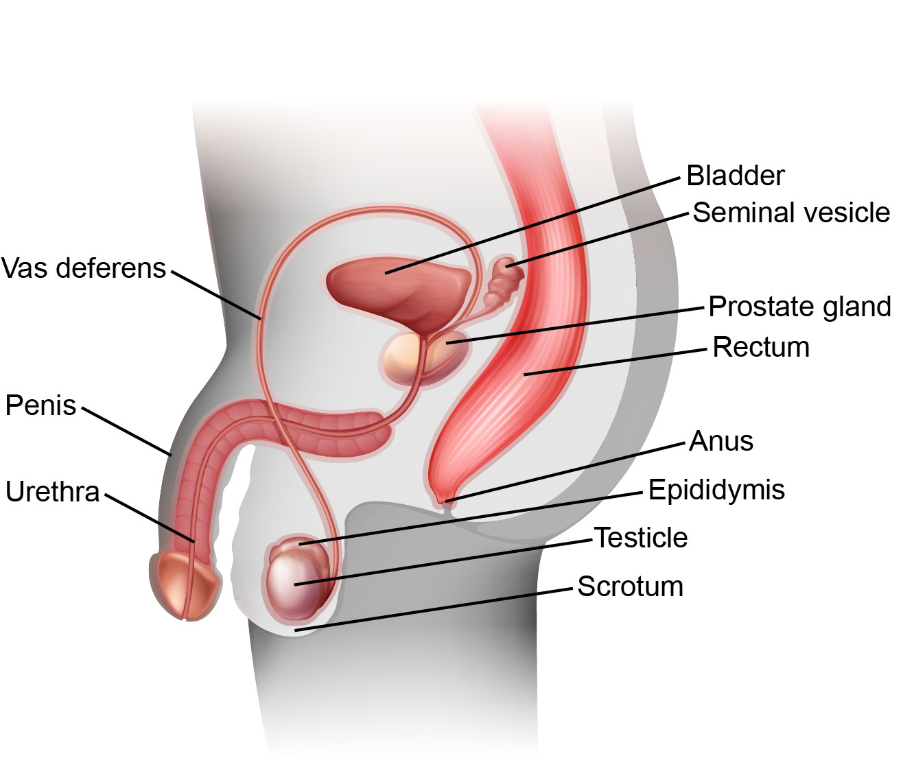
Internal Reproductive Organs

Slide 34
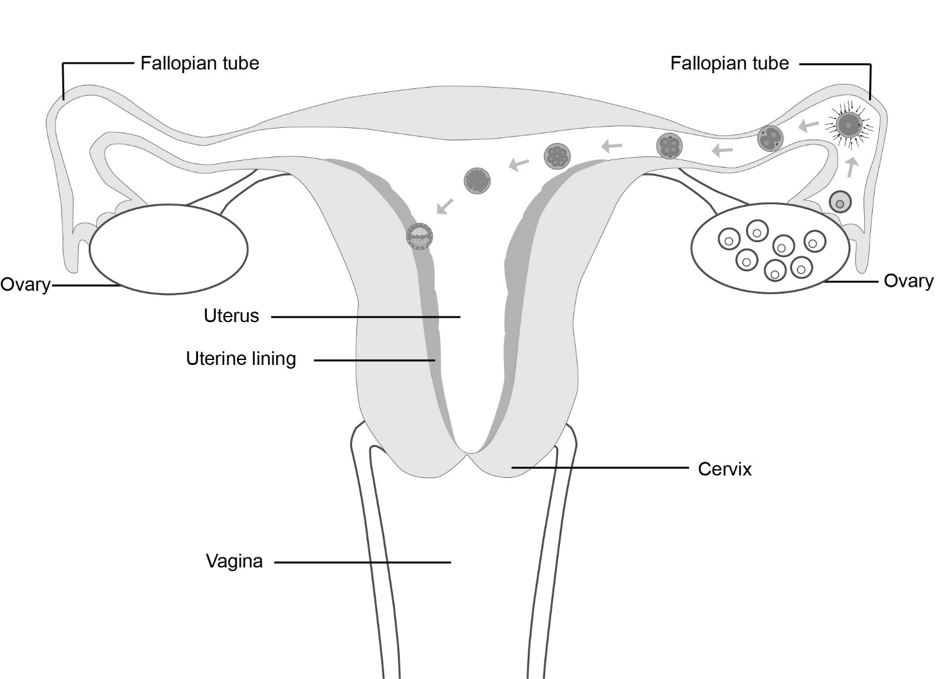
Implantation

Slide 35
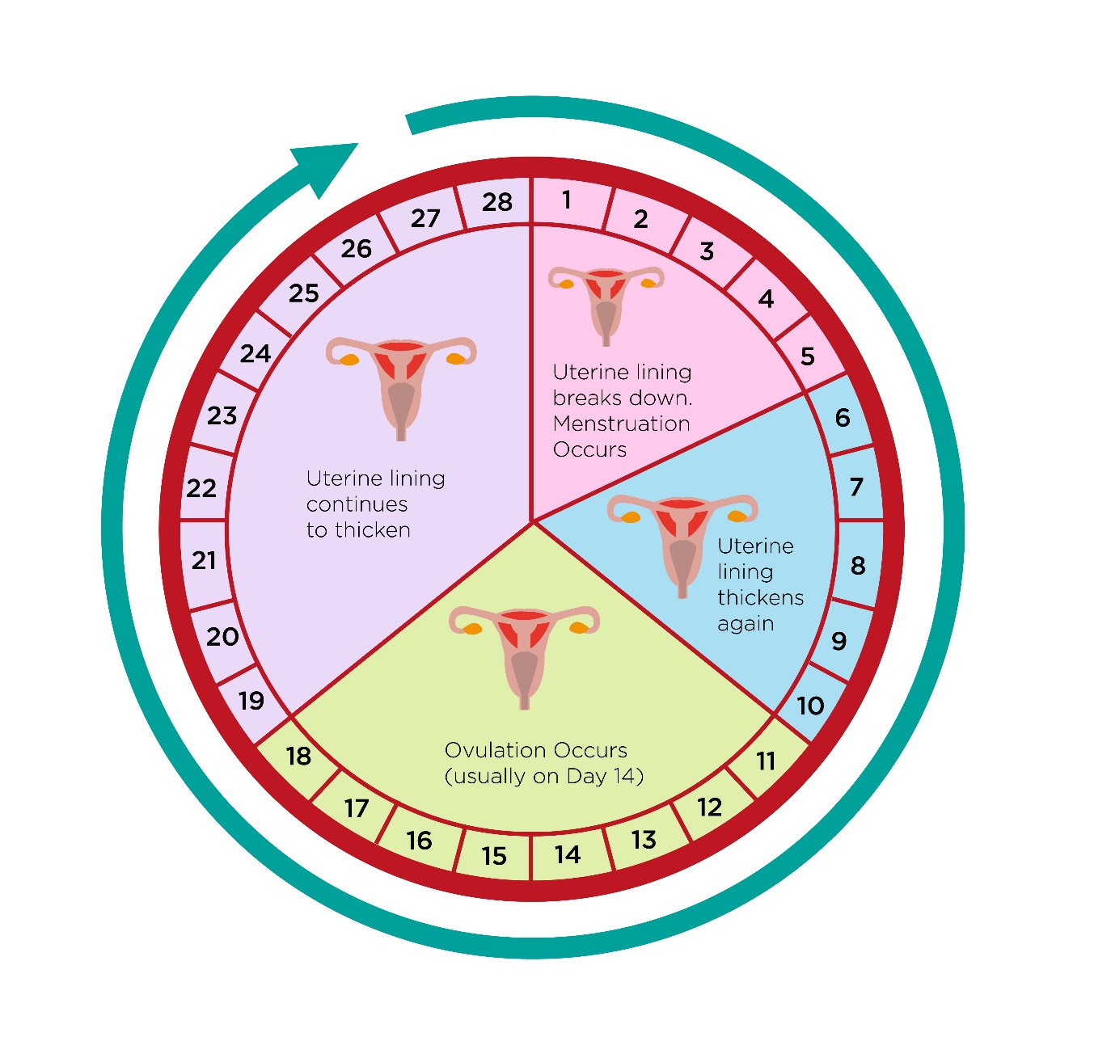
Menstrual Cycle
This diagram shows a menstrual cycle of 28 days, which is an average. Cycles can vary between 24-38 days long.

Slide 36
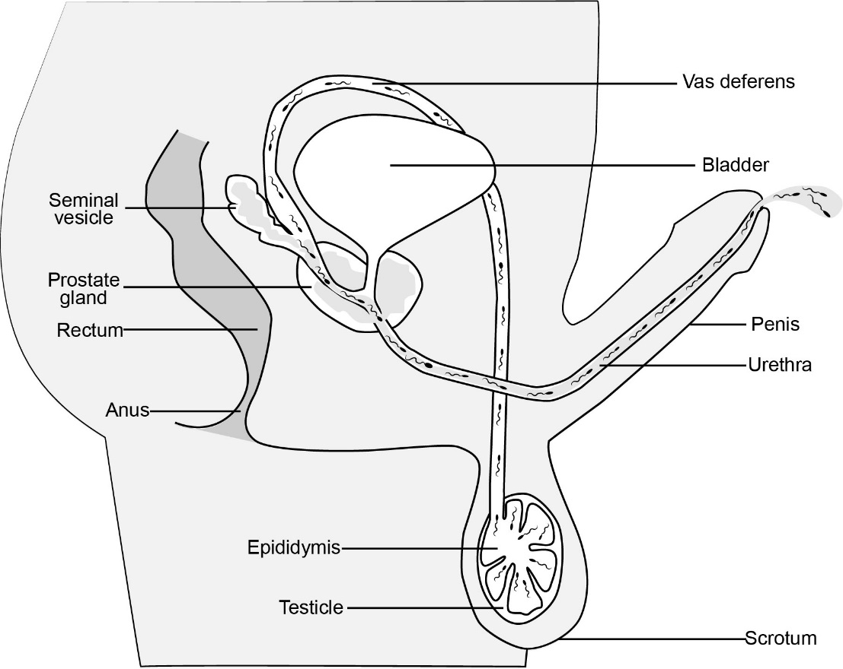
Sperm Production

Slide 37
CALM
Personal Values and Decision Making

Slide 38
How to Know Your Values
Is this something that’s important to you?
Do you feel good about this being important to you?
Would you feel good if people you respect knew that this was important to you?
Have you ever done anything that indicates that this is important to you?
Is this something you would stand by even if others made fun of you for it?
Does this fit in with your vision of who you are?

Slide 39
A Model for Decision Making
Define the problem
Generate at least three options
Analyze the consequences
Make the choice
Reflect on your decision

Slide 40
Talking about Sex
Set Goals and Limits
Think about how far you want to go and set your own limits.
Don’t do anything you don’t want to do.
Use assertive communication.
Make sure your partner knows how you feel and will respect the limits you set.

Slide 41
Talking about Sex
Help Prevent STIs
If you or your partner has had sex before, get tested for STIs.
Use a condom/vaginal condom/dental dam every time you have sex.

Slide 42
Talking about Sex
Help Prevent Pregnancy
Talk to your partner before you have sex about birth control.
Choose an effective method that you will use correctly and consistently.

Slide 43
Talking about Sex
I don’t think I am ready. Now what?
SAY NO! You have the right to say no to sex and you should not feel guilty about your decision.
You have more time to think and talk about your relationship with your partner.

Slide 44
Talking about Sex
I am ready but my partner isn’t. Now what?
Accept your partner’s ‘no’. They have the right to say no to sex and have that decision be respected.
Rejection can hurt, but how you respond to it matters. It is okay to feel hurt, sad, disappointed, angry, confused etc. But it is not your partner’s responsibility to make you feel better. Take time for yourself if you need it.
Give your self credit for being vulnerable and taking the emotional risk of asking. These experiences can be opportunities for growth.
If you are having trouble respecting the boundaries of others, you have a responsibility to ask for help.

