Slide 1
CONSENT
Which Path Would YOU Take?
©2020

Slide 2
This is Lupe and Jordan. They are in grade 12 and have been dating for almost one year.

Slide 3
They met at _________
a party | b) a football game | c) school

Slide 4
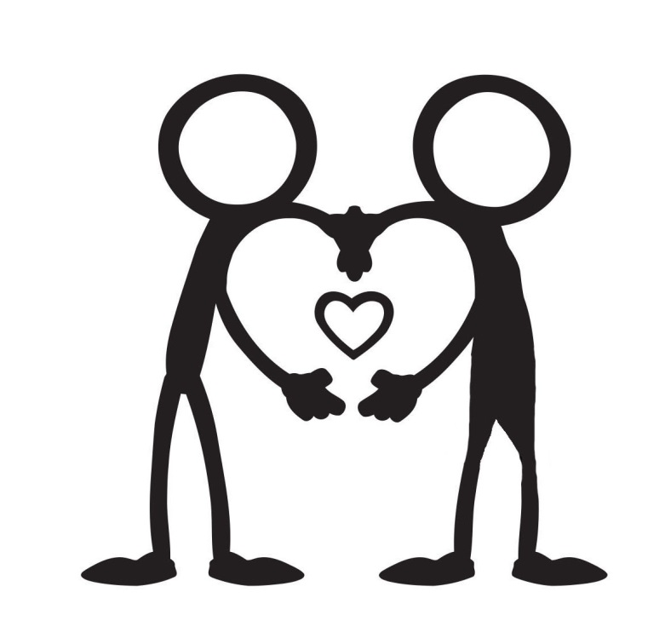
Lupe and Jordan spend a lot of time together and they like to make out. But Lupe really wants to have sex with Jordan. So Lupe…
goes for it and tries to unzip Jordan’s pants.
asks Jordan, “Can we talk about having sex?”
says, “I would really like to have sex with you.”

Slide 5
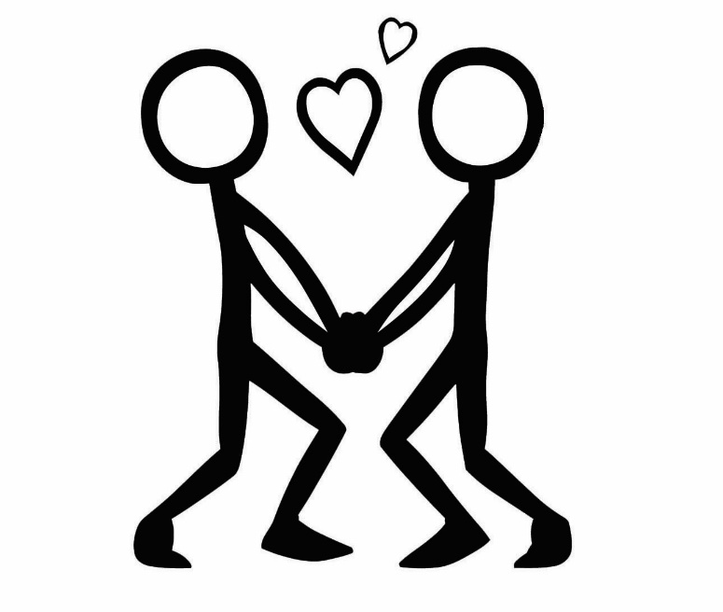
Jordan responds…
by saying, "I've been thinking about this too. I would like that, but we need to talk about protection.”
by saying, “I like just making out. I don’t want things to change.”
by not saying anything.

Slide 6
Lupe…
thinks because Jordan didn’t say no, it’s the green light to go ahead. So Lupe starts kissing Jordan.
b) says, “You’re not saying anything. What does that mean?”

Slide 7
Jordan doesn’t know what to do or say and becomes distant and unresponsive.
Lupe starts to unzip Jordan’s pants.
b) Lupe senses something is not right and asks Jordan, “Is everything ok?”

Slide 8
Jordan says “I need time to think about this. I kind of like the way things are.” Lupe responds,
“Come on! We’ve been dating forever. Besides, you’re such a tease. You make out with me all the time. We should just have sex already.”
“Ok, I get it. I just really like you a lot.”

Slide 9
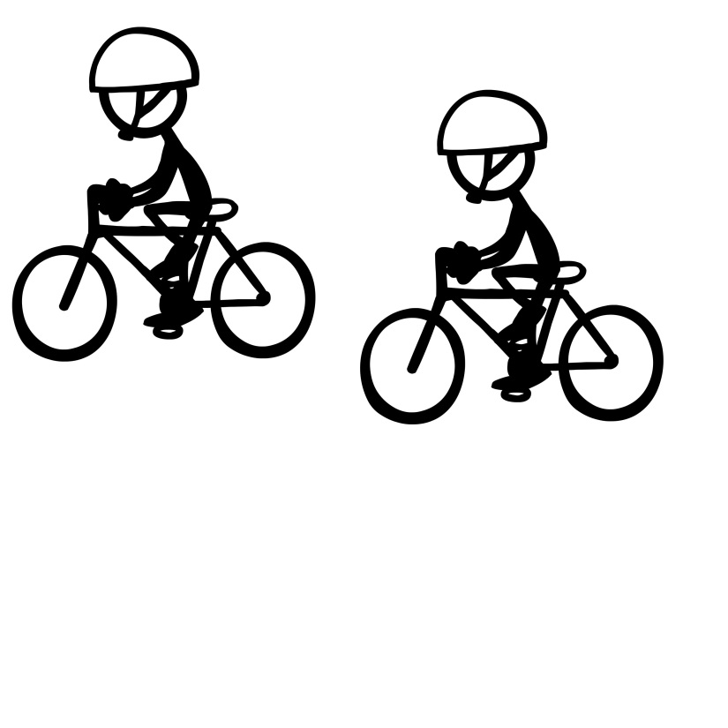
Jordan says, “Yup I think going to a clinic is a good idea. How about tomorrow after school?” Lupe says “Sounds like a plan. What do you want to do now?”
Eat pizza | b) Go to a movie | c) Go for a bike ride

Slide 10
Jordan…
says, “Whoa, if we take this further, we have to talk about protection.”
says “What are you doing?” and slaps Lupe’s hand away.
freezes, not knowing what to do or say.

Slide 11
Lupe says…
“Oh yeah, I guess we should talk about protection. Maybe we should go to a clinic or something.”
“Come on, it’ll be fine without protection just this once. Don’t you trust me?”

Slide 12
Jordan says, “Yes I do trust you, but trust me that we aren’t going to have unprotected sex.” Lupe responds,
“You’re right. It’s not a good idea. Maybe we should go to a clinic or something?”
“Whatever. I’m sick and tired of waiting for you. Maybe we should break-up”

Slide 13
Jordan responds by pushing Lupe’s hand away and says, “I just remembered I have a math test tomorrow.” Lupe says,
“You don’t seem to like me as much as I like you. Maybe we should break up.”
“Are you ok with taking this further?”

Slide 14
Lupe says…
“I really want to take our relationship to the next level.”
“Shoot I’m sorry. I should’ve asked you before I unzipped your pants. I’d like to take our relationship to the next level. I can see by your reaction you’re not into that?”

Slide 15
Jordan says “No, I’m not ready.” Lupe replies,
“Come on! We’ve been dating forever. Besides, you’re such a tease. You make out with me so that means we should have sex.”
“Ok, I’m sorry. I just really like you a lot. Can we talk about this again when you’re ready?”

Slide 16
Jordan says, “No, I’m not ready.” Lupe replies, “You clearly don’t like me as much as I like you. Maybe we should break up.” Jordan says, “Fine, we are broken up. I’m going to ________ with my friends now. Later!”
eat pizza | b) go to a movie | c) go for a bike ride

Slide 17
Lupe replies,
“Come on! We’ve been dating forever. Besides, you’re such a tease. You make out with me so that means we should have sex.”
“I just really like you a lot and feel ready to move our relationship forward. Can we talk about this again when you’re ready?”

Slide 18
Lupe…
senses that something is off and says “you really don’t seem into this.”
kisses Jordan who must be ok with this since Jordan did not say “stop” or push Lupe away.

Slide 19
Jordan says “I’m not ready for this.” Lupe replies,
“Come on! We’ve been dating forever. Besides, you’re such a tease. You make out with me all the time so that means you want to have sex with me. If you don’t have sex with me, I want to break up.”
“I’m sorry, I should have asked you before I unzipped your pants. Can we talk about this when you’re ready?”

Slide 20
Jordan becomes even more distant and is not responding. Lupe says,
“You don’t seem to like me as much as I like you. Maybe we should break up.”
“Are you ok with taking this further?”

Slide 21
Jordan says, “I’m just not ready for this. I hope you’re cool with that.” Lupe replies, “Of course. But can we talk about this when you’re ready?” Jordan says, “For sure. What do you want to do now?”
Eat pizza | b) Go to a movie | c) Go for a bike ride

Slide 22
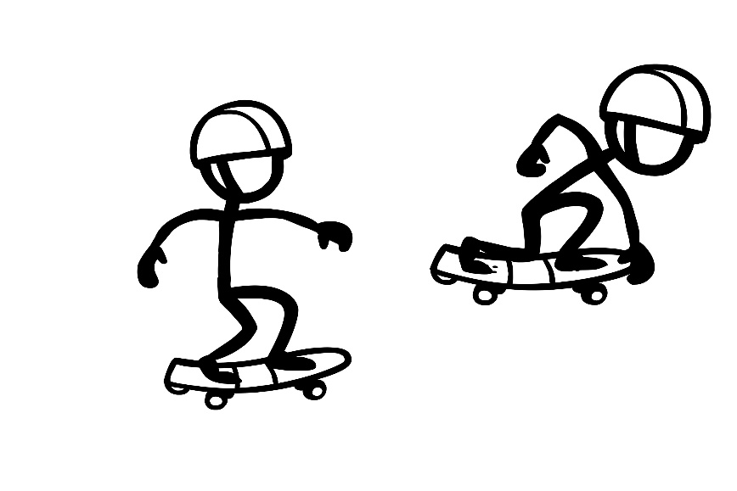
Jordan says, “That’s ok we’re cool. I’ll let you know when I’m ready to talk about this again. What do you want to do now?”
Go skateboarding | b) Go for a pizza | c) Go to a movie

Slide 23
Jordan says, “Fine, then let’s break up. I’m going to ________ with my friends now.”
go for a pizza | b) shoot hoops | c) listen to music

Slide 24
Jordan says, “I really like you a lot too. That’s why I don’t want anything to change right now.” Lupe responds, “I get it. What do you want to do right now?
Go for a bike ride | b) Shoot hoops | c) Listen to music

Slide 25
Jordan says “I’m not ready for this.” Lupe replies,
“Come on! We’ve been dating forever. Besides, you’re such a tease. You make out with me all the time so that means you want to have sex with me. If you don’t have sex with me, I’ll break up with you.”
“Ok that’s cool. Can we talk about this when you’re ready?”

Slide 26
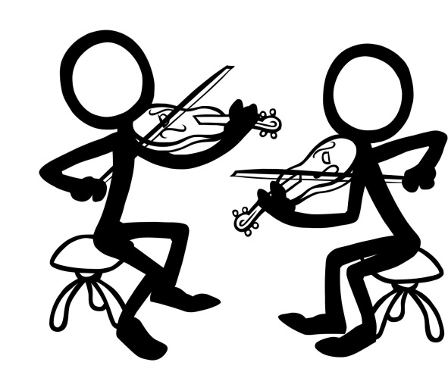
Jordan says, “For sure! What do you want to do now?”
Go to band practice | b) Shoot hoops | c) Listen to music

Slide 27
The End
Back to the beginning

